Slide 1

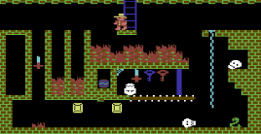
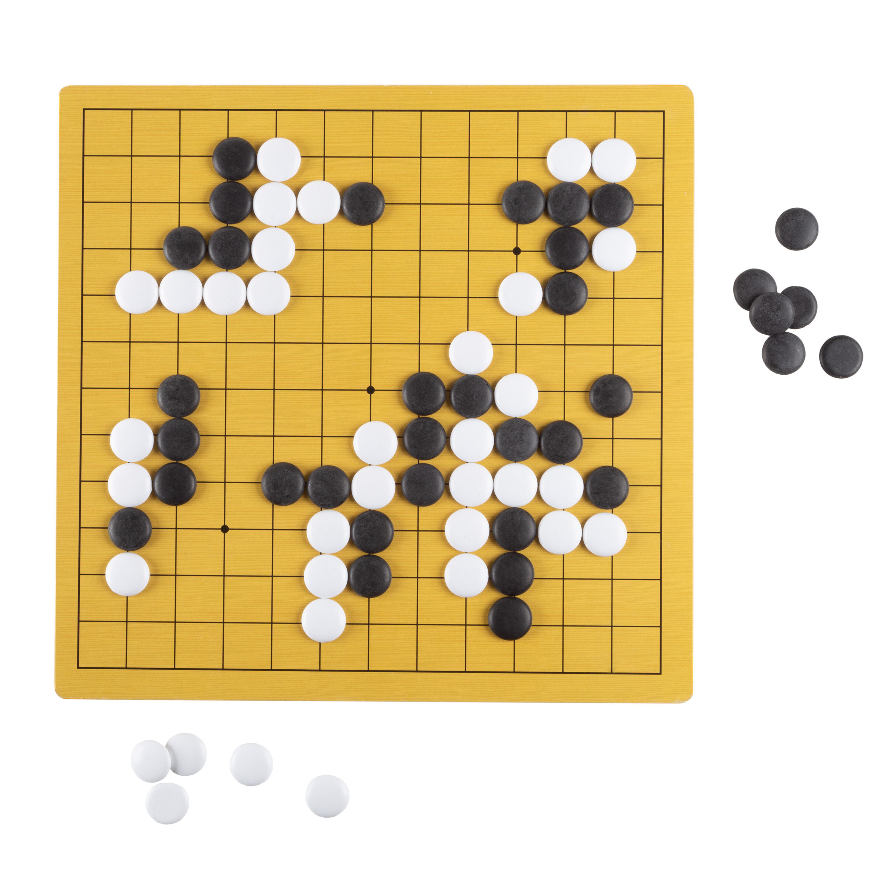
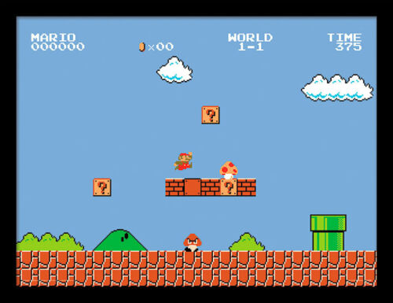
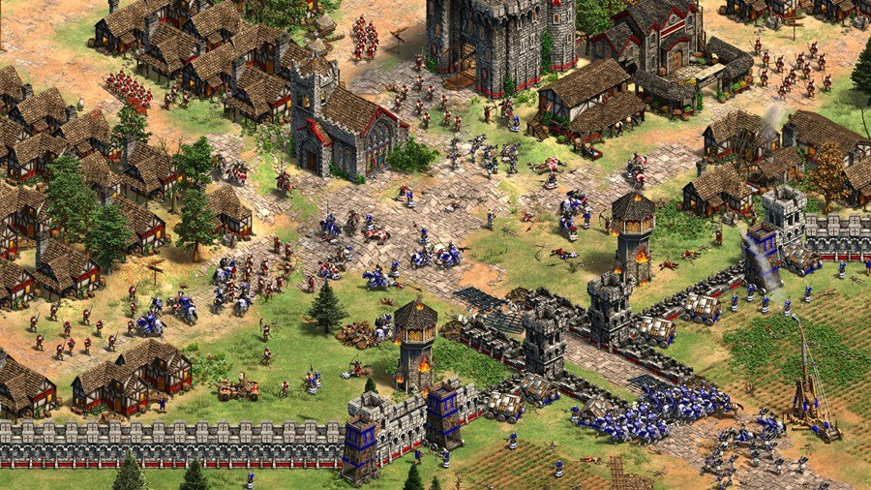
Game AI Programming
Part one - Based on Prof. Horst Eidenberger`s Leture on Strategy Game Programming @TU Vienna
Part two based on David Silvers slides and Lectures, at al.
Prepared by Lukas Steindl, September 21

Slide 2
Introduction
Lukas Steindl,
10+ years at Microsoft mainly working with database systems
BSc. in Business Informatics from University of Hagen,
Currently doing my master thesis https://github.com/embedded-machine-learning/ragweed-drone-detection as part of the Data Science Master @ TU Vienna
Github: https://github.com/LukasSteindl

Slide 3
Agenda
Traditional Game AI Algorithms
Minimax algorithm
Alpha Beta Pruning
Monte Carlo Tree Search
A brief introduction to Reinforcement Learning
Microsoft Offerings
Deep Reinforcement Learning (RL) with Azure ML
If time permits: AlphaGo, AlphaGo Zero, AlphaZero, MuZero

Slide 4
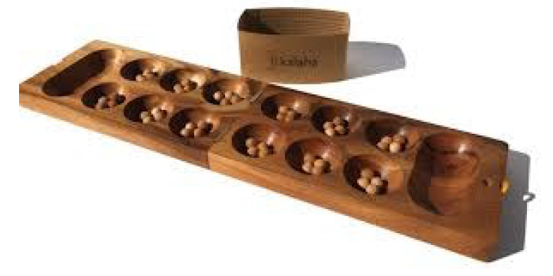
Lab Project
Students should be able to implement a Game AI for the Mancala Game Engine. (by Robert Fischer https://github.com/metzzo )
Agents will play against each other!

Slide 5
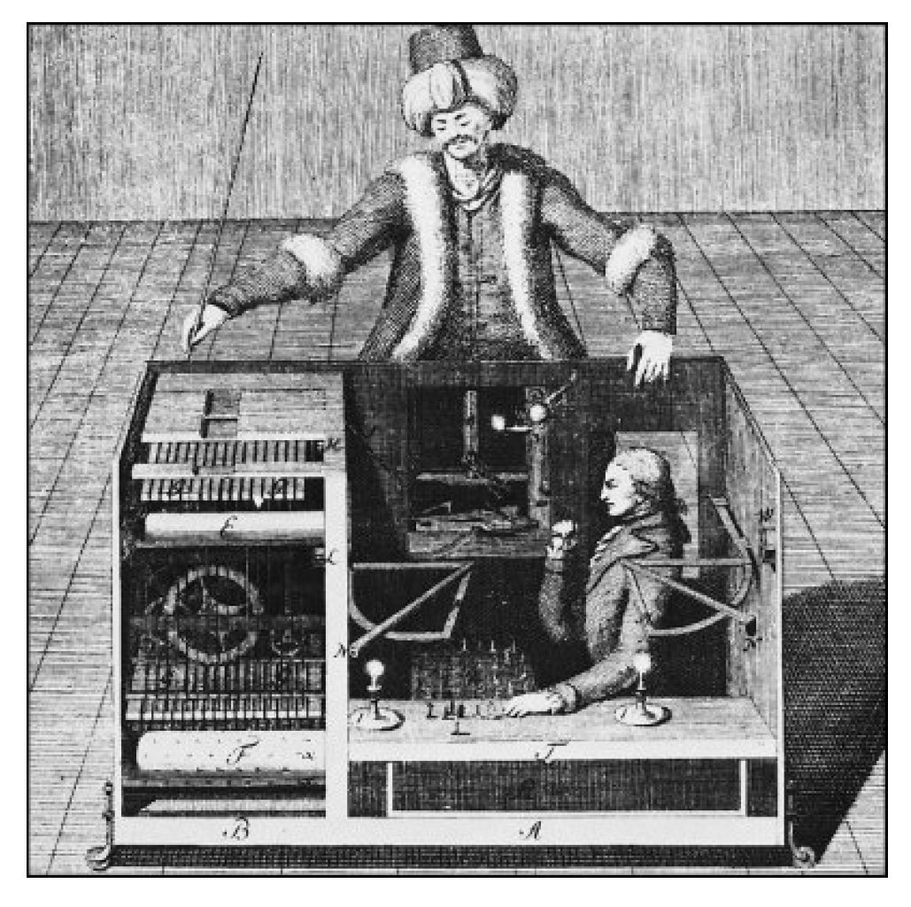
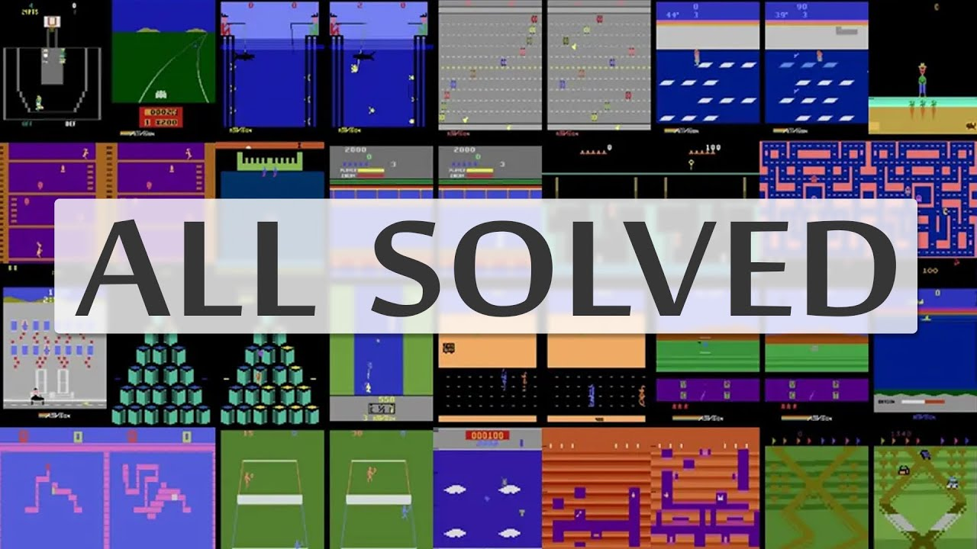
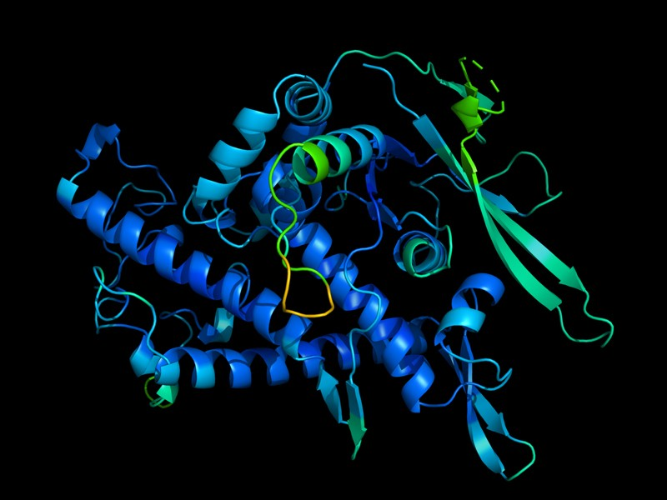
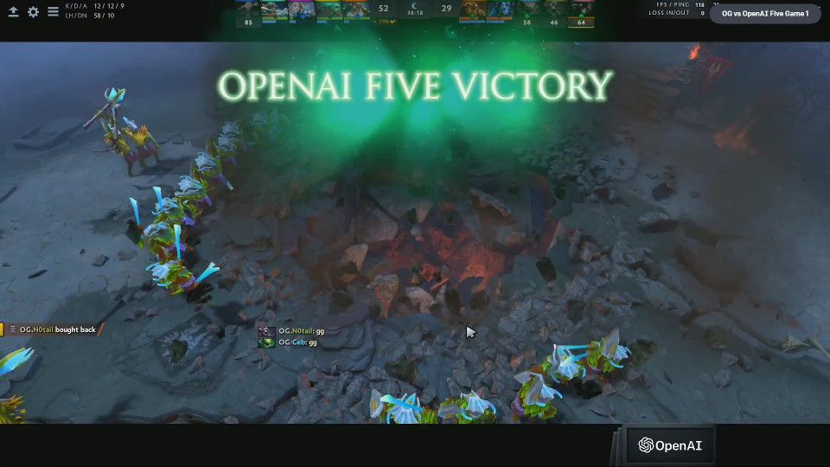
History of Game Machines
18th century: The Turk: Fake chess machine
1970ies: First chess programs
1997: Deep Blue beats chess world champion
2015: DeepMind solved all Atari Games (Agent 57)
2016: AlphaGo beats Lee Sedol in the Game of GO
2017: OpenAI wins Dota2 in 1on1
2018: AlphaStar wins Starcraft
2019: OpenAI wins Dota2 in 5on5
2020 Deep Mind practically „solved“ Proteinfolding
despite beeing NP-Complete
Notes:
Could also be used for other NP complete problems as heuristic (e.g traveling salesman)

Slide 6
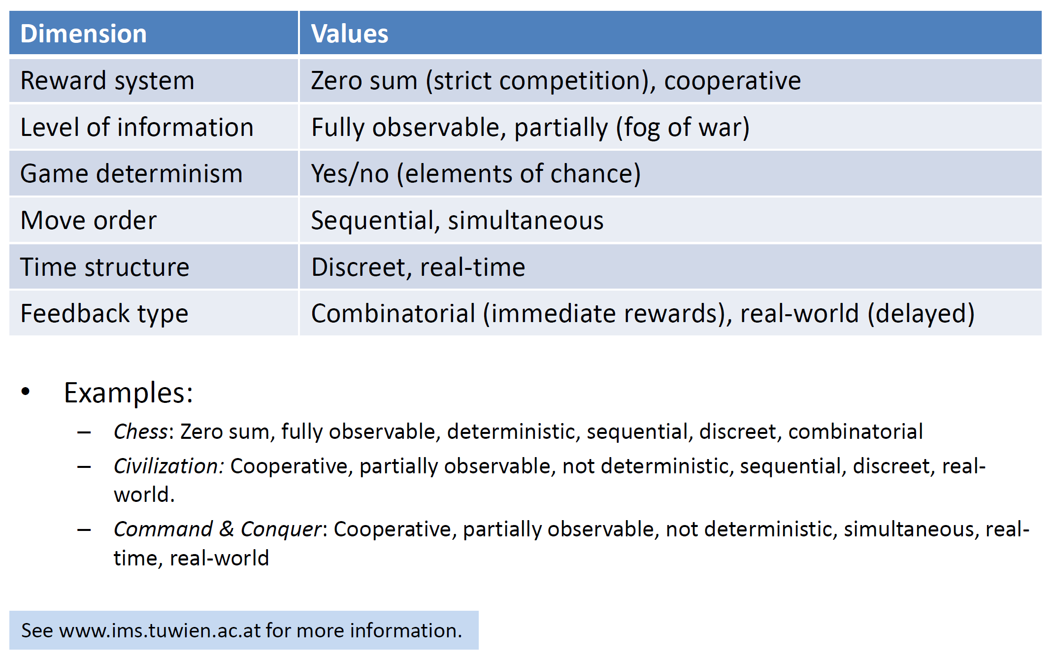
What Makes a Game?

Slide 7
Algorithmic Concepts & Terms
What makes a strategy?
Rules, freedom of choice, rewards for actions
Search strategies:
Dumb fast (e.g Minimax) -> Exhaustive tree search (trying out all moves)
Smart slow (e.g MCTS)
Search stability:
Fail hard: deterministic, stable, expensive
Fail soft: probabilistic, heuristic, unstable, cheaper

Slide 8
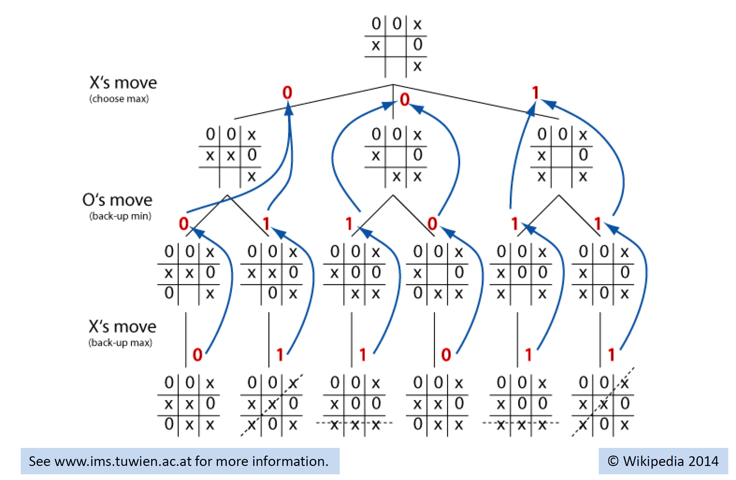
tic toe- Dumb Fast: Minimax Algorithm
Notes:
Game Trees are just trees, and nodes are game states.
Finding future positions that are favorable or unfavorible (e.g. number of chess elements on the board)
If the tree branches really wide, then the tree cannot be rolled out anymore,
That is the case of game of GO
Game of GO 10^170 states vs Chess 10^123 Sates

Slide 9
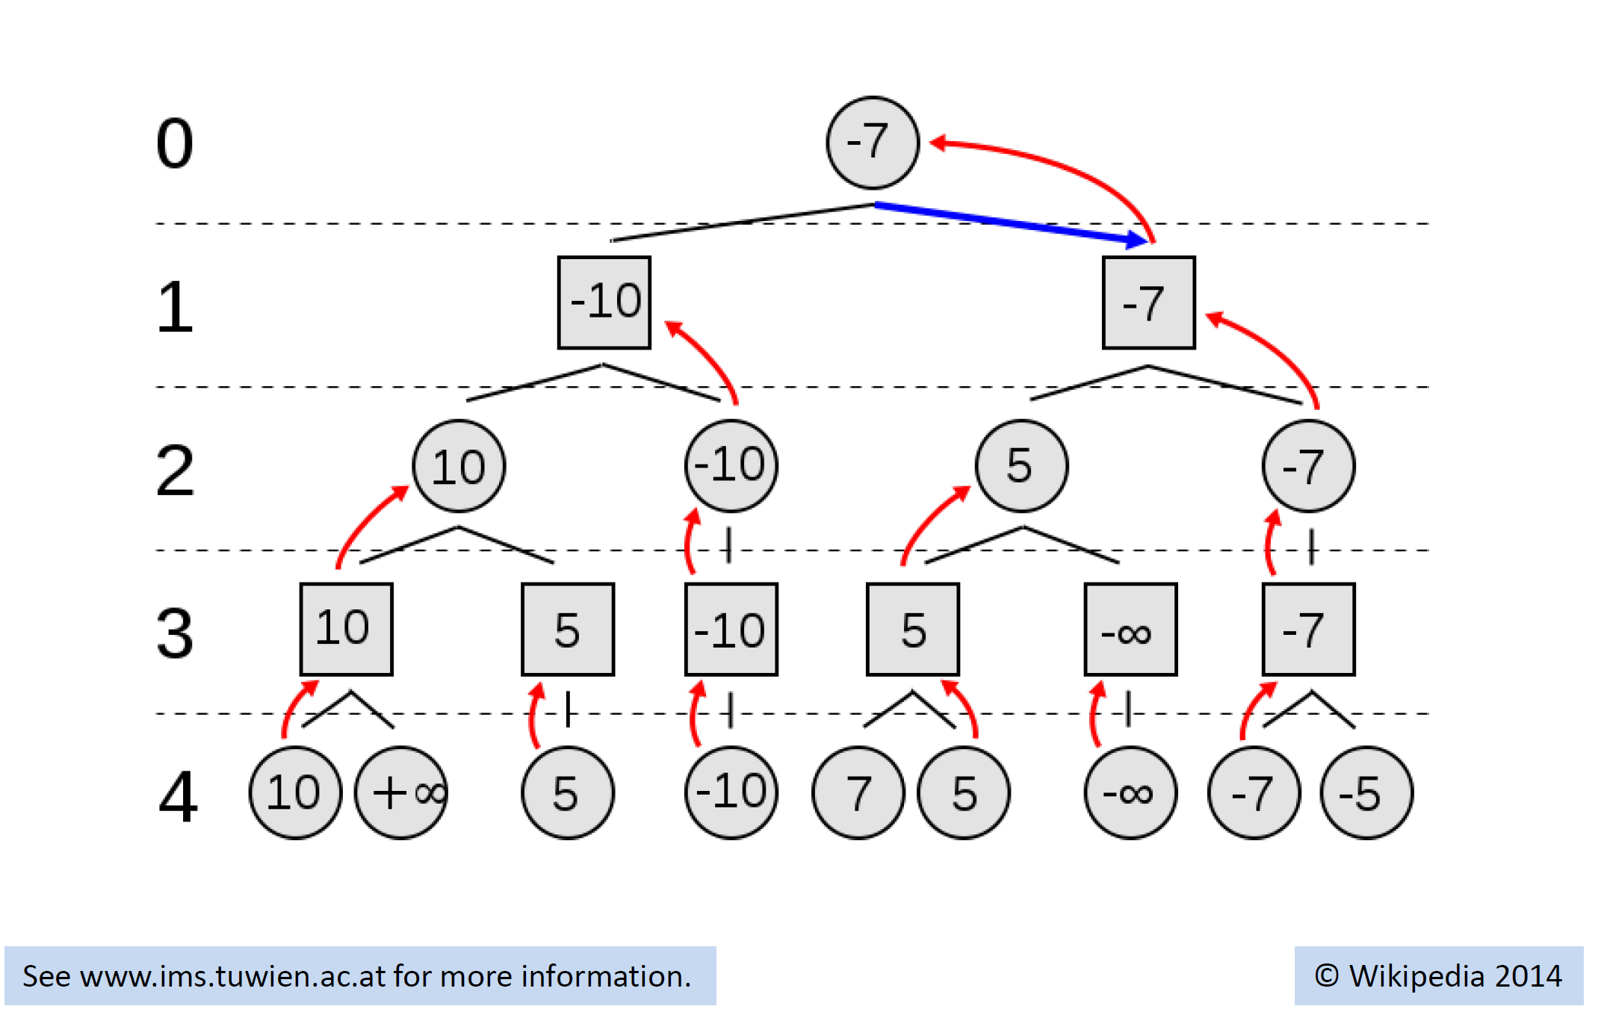
Numeric Example
Even player always wants to maximize his reward
Odd player always wants to minimize his reward
Actual outcome for the even Player

Slide 10
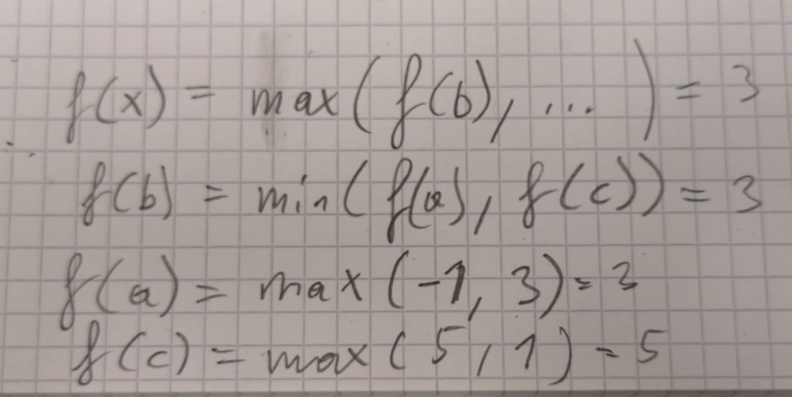
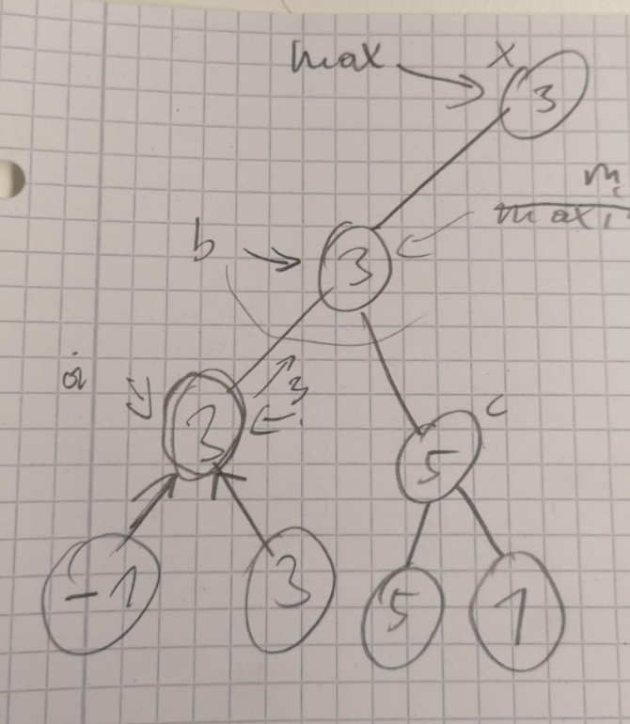
Minimax all you need is a recursive function f(gamestate,player) to evaluate the value of every move that is currently possible.
Anchor of the recursion when the leave node is reached (depthcounter = 0)
https://www.youtube.com/watch?v=l-hh51ncgDI&t=250s&ab_channel=SebastianLague
Notes:
man muss nur eine funktion f (gameposition, currentplayer) schreiben die jeweils alle moves in einer gameposition auswertet und dann je nach currentplayer das minimum oder das maximum der bewerteten moves zurückgibt.

Slide 11
Alpha Beta Pruning
Idea: do not explore paths when the player in the current position would never go that way.
This can happen when doing a move would provide the opponent with a higher scoring move as already observed.
https://www.youtube.com/watch?v=l-hh51ncgDI&t=250s&ab_channel=SebastianLague

Slide 12
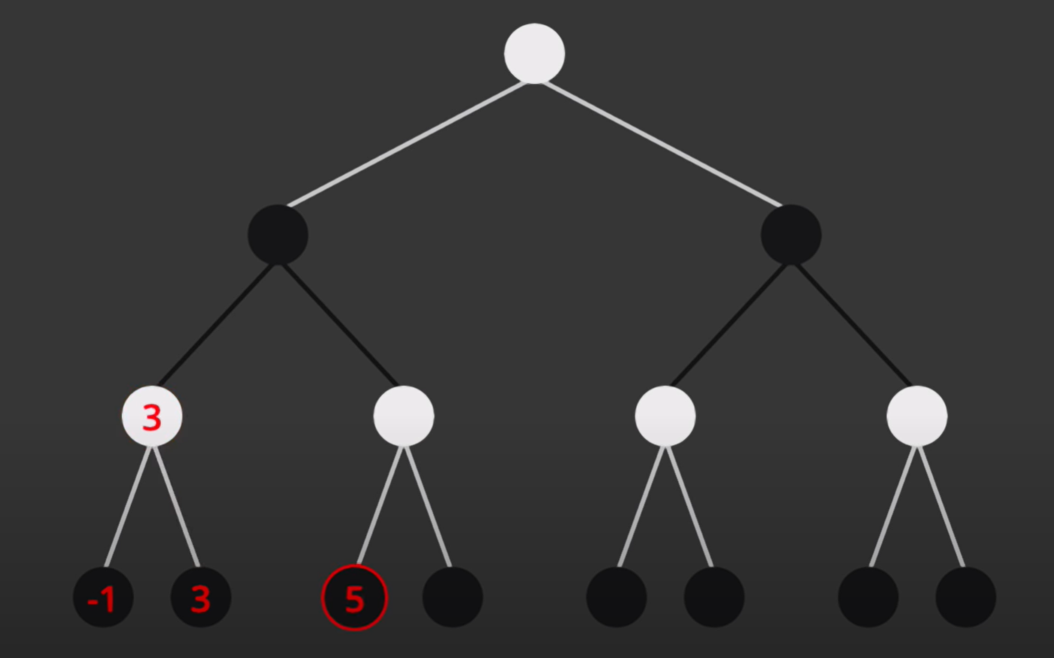
Alpha Beta Pruning
Not necessary to look into the right branch, since the black player would never choose it as It would give the white player the option for a higher reward
Minimizing
Long time the state of the art for chess (using domain expert evaluation functions)

Slide 13
Problems in Case of
High Branching Factor (e.g Game of GO)
Missing Evaluation function

Slide 14
Monte Carlo Tree Search – slow and smart
MCTS creates a statistics tree (describing the value of a position)
Idea is to focus the search time to more relevant options.
It comes up with these values by simulating steps (first random later more exploiting)
Selection, Expansion, Simulation, Update -> https://www.youtube.com/watch?v=Fbs4lnGLS8M&ab_channel=FullstackAcademy
Open Ended Environments (no domain dependent evaluation function required)
Notes:
Unlike minimax, the MCTS can work in very open-ended environments with a high branching factor, making it much more effective in games like Go, where the sheer amount of possibilities and choices are just too great for the brute force approach. It also does not require an evaluation function to determine the value of a game state, making it much more "adaptable" to different environments. The MCTS uses 4 main functions (Select, Expand, Simulate, and Update) to create an asymmetric statistics tree which maps onto a game tree, which an AI can then use to ultimately make the "right decision

Slide 15
Selection, Expansion, Simulation, Update
MCTS begins with a stats tree

Slide 16
Selection, Expansion, Simulation, Update
Expansion

Slide 17
Selection, Expansion, Simulation, Update
Simulation
Playout with Random Moves for itself and the opponent
W

Slide 18
Selection, Expansion, Simulation, Update
Update
1/1
Update the Statistics Information 1 win out of 1 try
W

Slide 19
Selection, Expansion, Simulation, Update
Same for the remaining actions
At this point the left node would be the best move!
But too small sample size to be sure!
1/1
0/1
0/1
Update the Statistics Information 0 win out of 1 try
L
L

Slide 20
Selection, Expansion, Simulation, Update
Selection
Now that all child nodes have been visited
The selection is based on how good are the stats?
How much has a child been ignored?
1/1
0/1
0/1

Slide 21
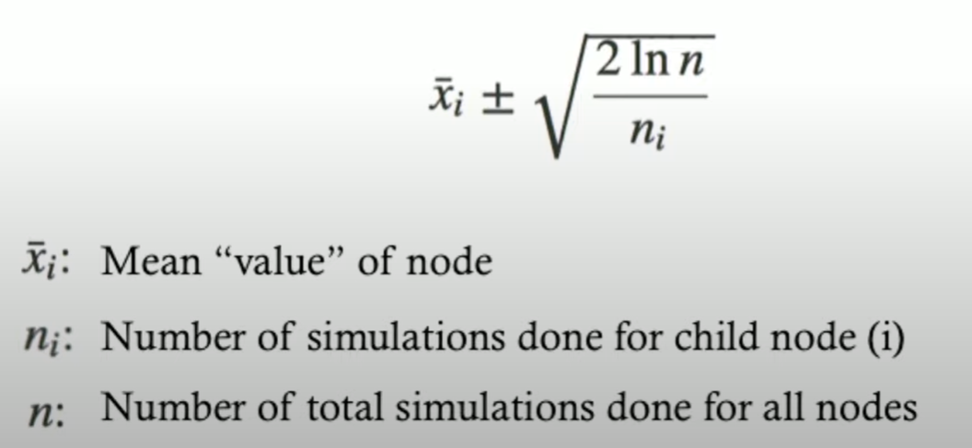
Selection, Expansion, Simulation, Update
Selection
Now that all child nodes have been visited
The selection is based on how good are the stats?
How much has a child been ignored?
With this you maintain a good balance between
Exploration and exploitation.
1/1
0/1
0/1

Slide 22
Selection, Expansion, Simulation, Update
Expansion
1/1
0/1
0/1

Slide 23
Selection, Expansion, Simulation, Update
Simulation
1/1
0/1
0/1
w

Slide 24
Selection, Expansion, Simulation, Update
Update
2/2
0/1
0/1
1/1
This time Update propagates back to the first child node.
So the Parent Node inherits the stats from its child nodes!
w

Slide 25
Selection, Expansion, Simulation, Update
Simulation & Update
2/4
0/1
0/1
1/1
0/1
0/1
Now that the child nodes of the last selection
Have all been explored at least once,
It will run the selection from the top again!
L
L

Slide 26
Selection, Expansion, Simulation, Update
Ignored 3 Times only
Ignored 3 Times only
Selection
2/4
0/1
0/1
1/1
0/1
0/1
Say that we still pick the first child of the root.
As 50% is still very high and we only ignored the other
Direct childs of the root three times!

Slide 27
Selection, Expansion, Simulation, Update
Selection
2/4
0/1
0/1
1/1
0/1
0/1
As all the child nodes have been expanded already,
It will run the selection again, this time selecting
The left most node.

Slide 28
Selection, Expansion, Simulation, Update
Expansion, Simulation, Update,
2/5
0/1
0/1
1/2
0/1
0/1
0/1
L

Slide 29
Selection, Expansion, Simulation, Update
Selection
2/5
0/1
0/1
1/2
0/1
0/1
Now the algorithm decides
to explore the ignored nodes
0/1

Slide 30
Selection, Expansion, Simulation, Update
Expansion, Simulation, Update
2/5
0/1
1/3
1/2
0/1
0/1
1/1
0/1
0/1
W
L

Slide 31
Selection, Expansion, Simulation, Update
The longer you repeat, the more accurate your
estimates become!
After infinite iterations you would obtain a similar
Tree as minimax.
If you ask the system now to pick a move.
It would take the left most childnode of the rootnode.
Not because it has the highest chance but because
It was visited most often.
2/5
0/1
1/3
1/2
0/1
0/1
1/1
0/1
0/1

Slide 32

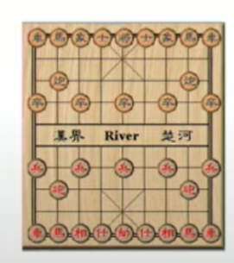
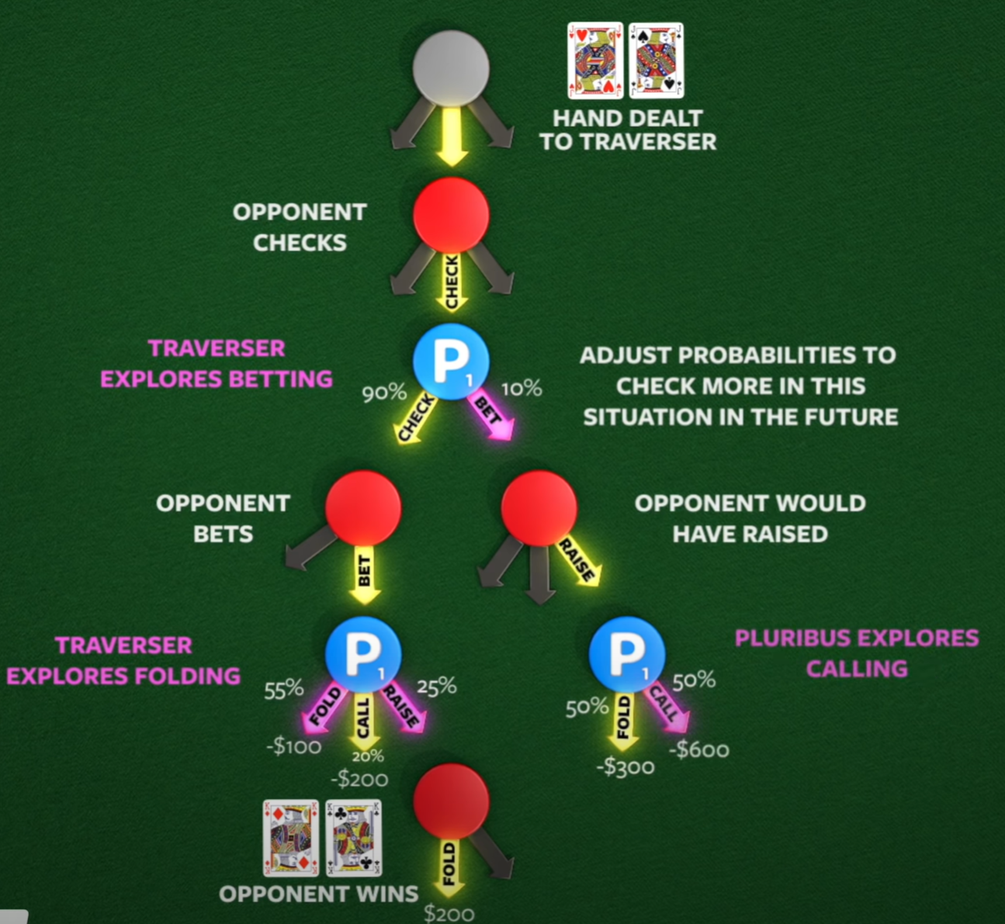
MCTS is domain independent!
In addition of being effective in situation with a very high branching factor MCTS is domain independent.
https://www.youtube.com/watch?v=u90TbxK7VEA&ab_channel=TwoMinutePapers

Slide 33
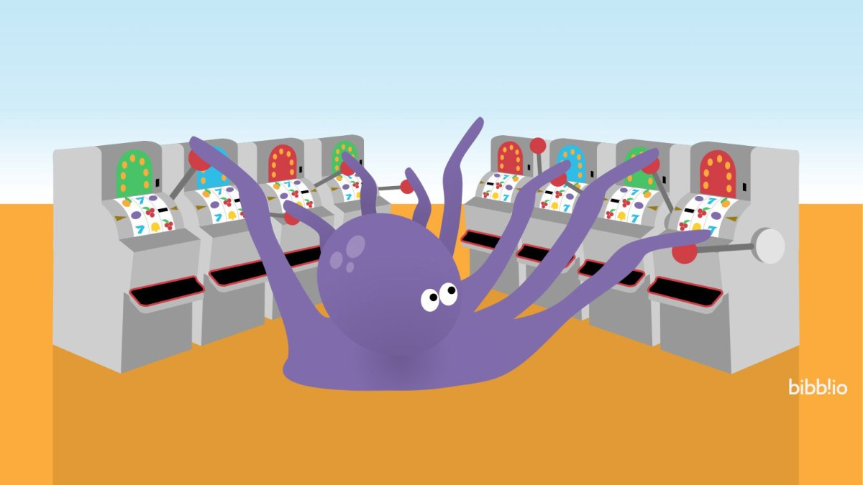
Bandit Based Methods
Exploration Only
Exploitation Only
Epsilon Greedy
https://www.youtube.com/watch?v=e3L4VocZnnQ&ab_channel=ritvikmath
Notes:
Exploration Only -> Pure Random
Exploitation Only -> Test each machine once, and then use only the machine with hightest reward on that run.
Epsilon Greedy (balance exploration vs exploitation, e.g Randomly Pick a machine in 10% of the cases, vs 90% picking the machine with highest mean reward so far.

Slide 34
Upper confidence bound, version 1 (UCB 1) Strategy
When you are uncertain about your estimate of the value of a move.
At each Time t, Pick Move such that
Mü_r + sqrt(2ln(t)/N_t(r)) is maximized
Where mü_r is the expoitation and the rest is the exploration.
https://www.youtube.com/watch?v=FgmMK6RPU1c&ab_channel=ritvikmath
Notes:
When you are uncertain about your estimate of the value of a move.
At each timepoint t> you pick the restaurant r such that…
Benefit of the doubt, lets try a move again when not tried often.

Slide 35
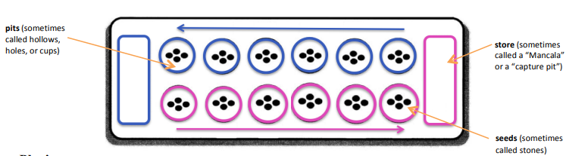
Lab
Basic Rules:
Play always moves around the board in a counter-clockwise circle (to the right)
* The store on your right belongs to you. That is where you keep the seeds you win.
* The six pits near you are your pits.
* Only use one hand to pick up and put down seeds.
* Once you touch the seeds in a pit, you must move those seeds.
* Only put seeds in your own store, not your opponent’s store.
Starting the Game: On a turn, a player picks up all the seeds in one pit and “sows” them to the right, placing one seed in each of the pits along the way. If you come to your store, then add a seed to your store and continue. You may end up putting seeds in your opponent’s pits along the way. Play alternates back and forth, with opponents picking up the seeds in one of their pits and distributing them one at a time into the pits on the right, beginning in the pit immediately to the right.
Special Rules:
*When the last seed in your hand lands in your store, take another turn.
*When the last seed in your hand lands in one of your own pits, if that pit had been empty you get to keep all of the seeds in your opponents pit on the opposite side. Put those captured seeds, as well as the last seed that you just played on your side, into the store.
Ending the Game: The game is over when one player’s pits are completely empty. The other player takes the seeds remaining in her pits and puts those seeds in her store. Count up the seeds. Whoever has the most seeds wins.

Slide 36
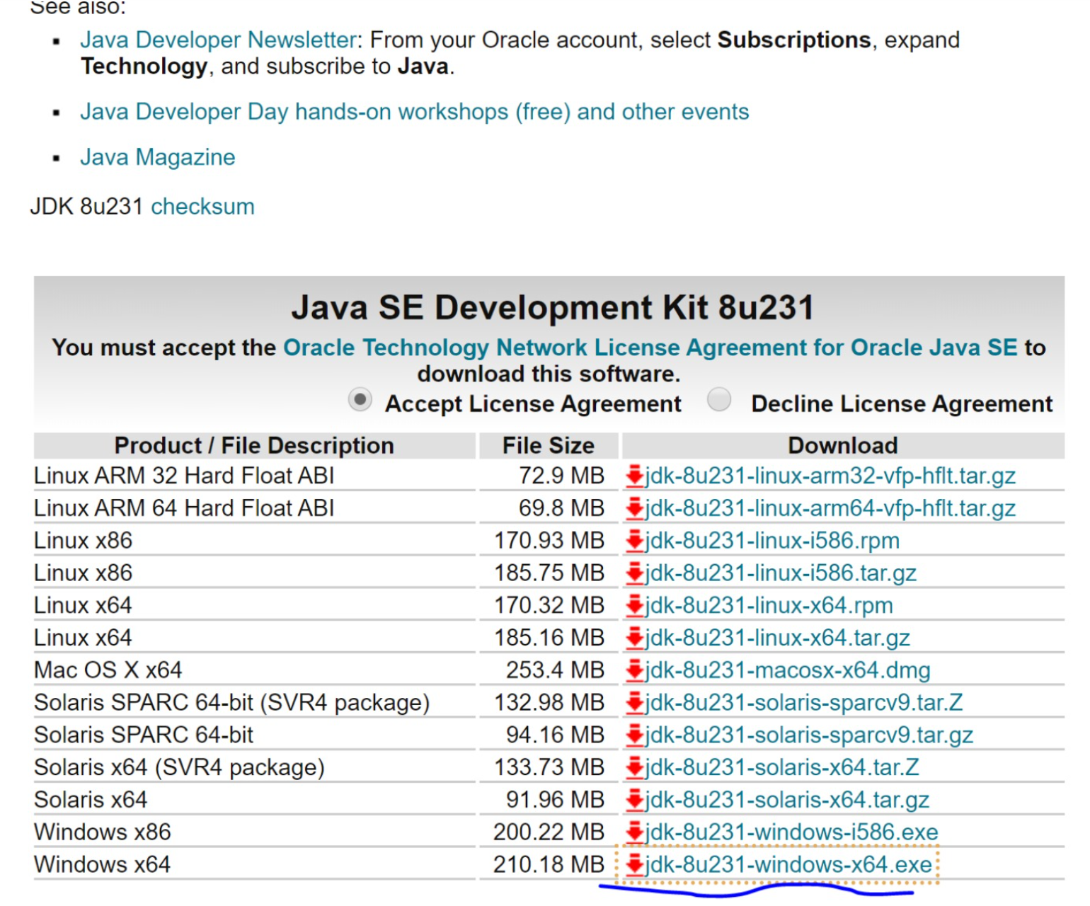
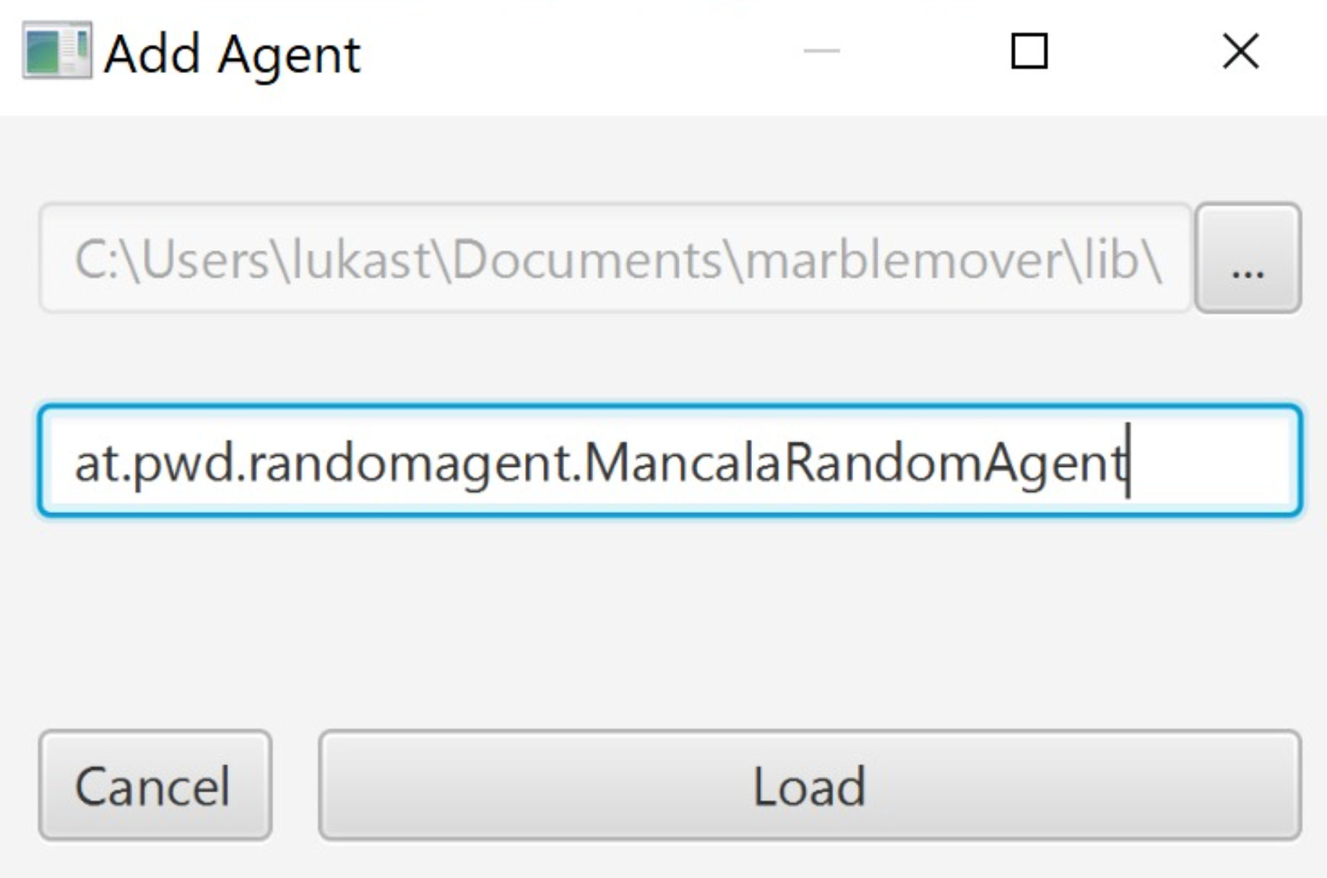
Game of Mancala
https://github.com/metzzo/mancala
Notes:
[08:44, 20.12.2019] Lukas Steindl: habs jetzt auf einem neuen rechner installiert und mal wieder a zeitl braucht bis es überhaupt lauft... zur Doku: man braucht unbedingt das JDK hier: und die JAVA_HOME variable muss auf das installationsverzeichnis dann zeigen exklusive \bin am ende[08:45, 20.12.2019] Lukas Steindl: bzgl. des problems dass er den agent nciht laden kann... ich hab die agent config ganz rauswerfen müssen um es überhaupt starten zu können... d.h im config file muss es zu beginn so aussehen:[08:45, 20.12.2019] Lukas Steindl: <config> <agents/> <computation-time>5</computation-time> <stones-per-slot>4</stones-per-slot> <slots-per-player>4</slots-per-player></config>

Slide 37
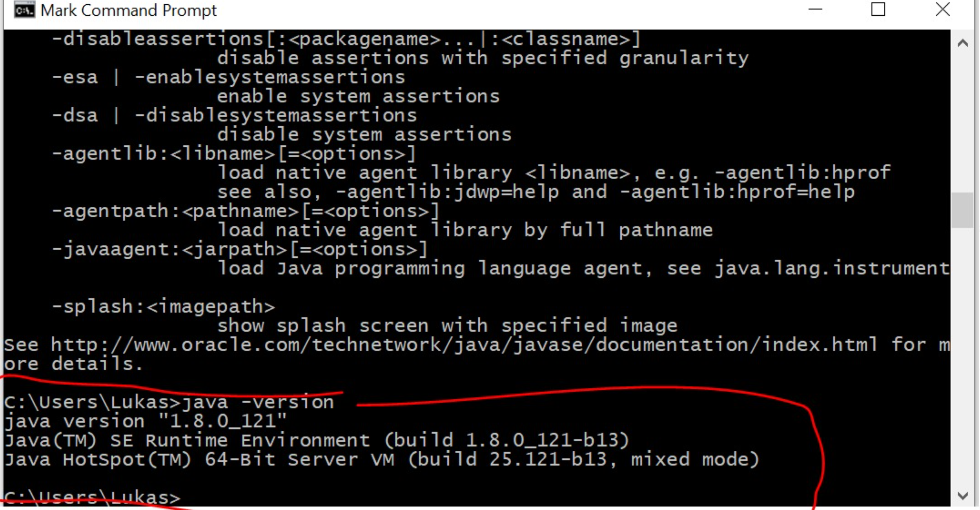
Notes:
Make sure classpath is set so that windows finds java.exe

Slide 38
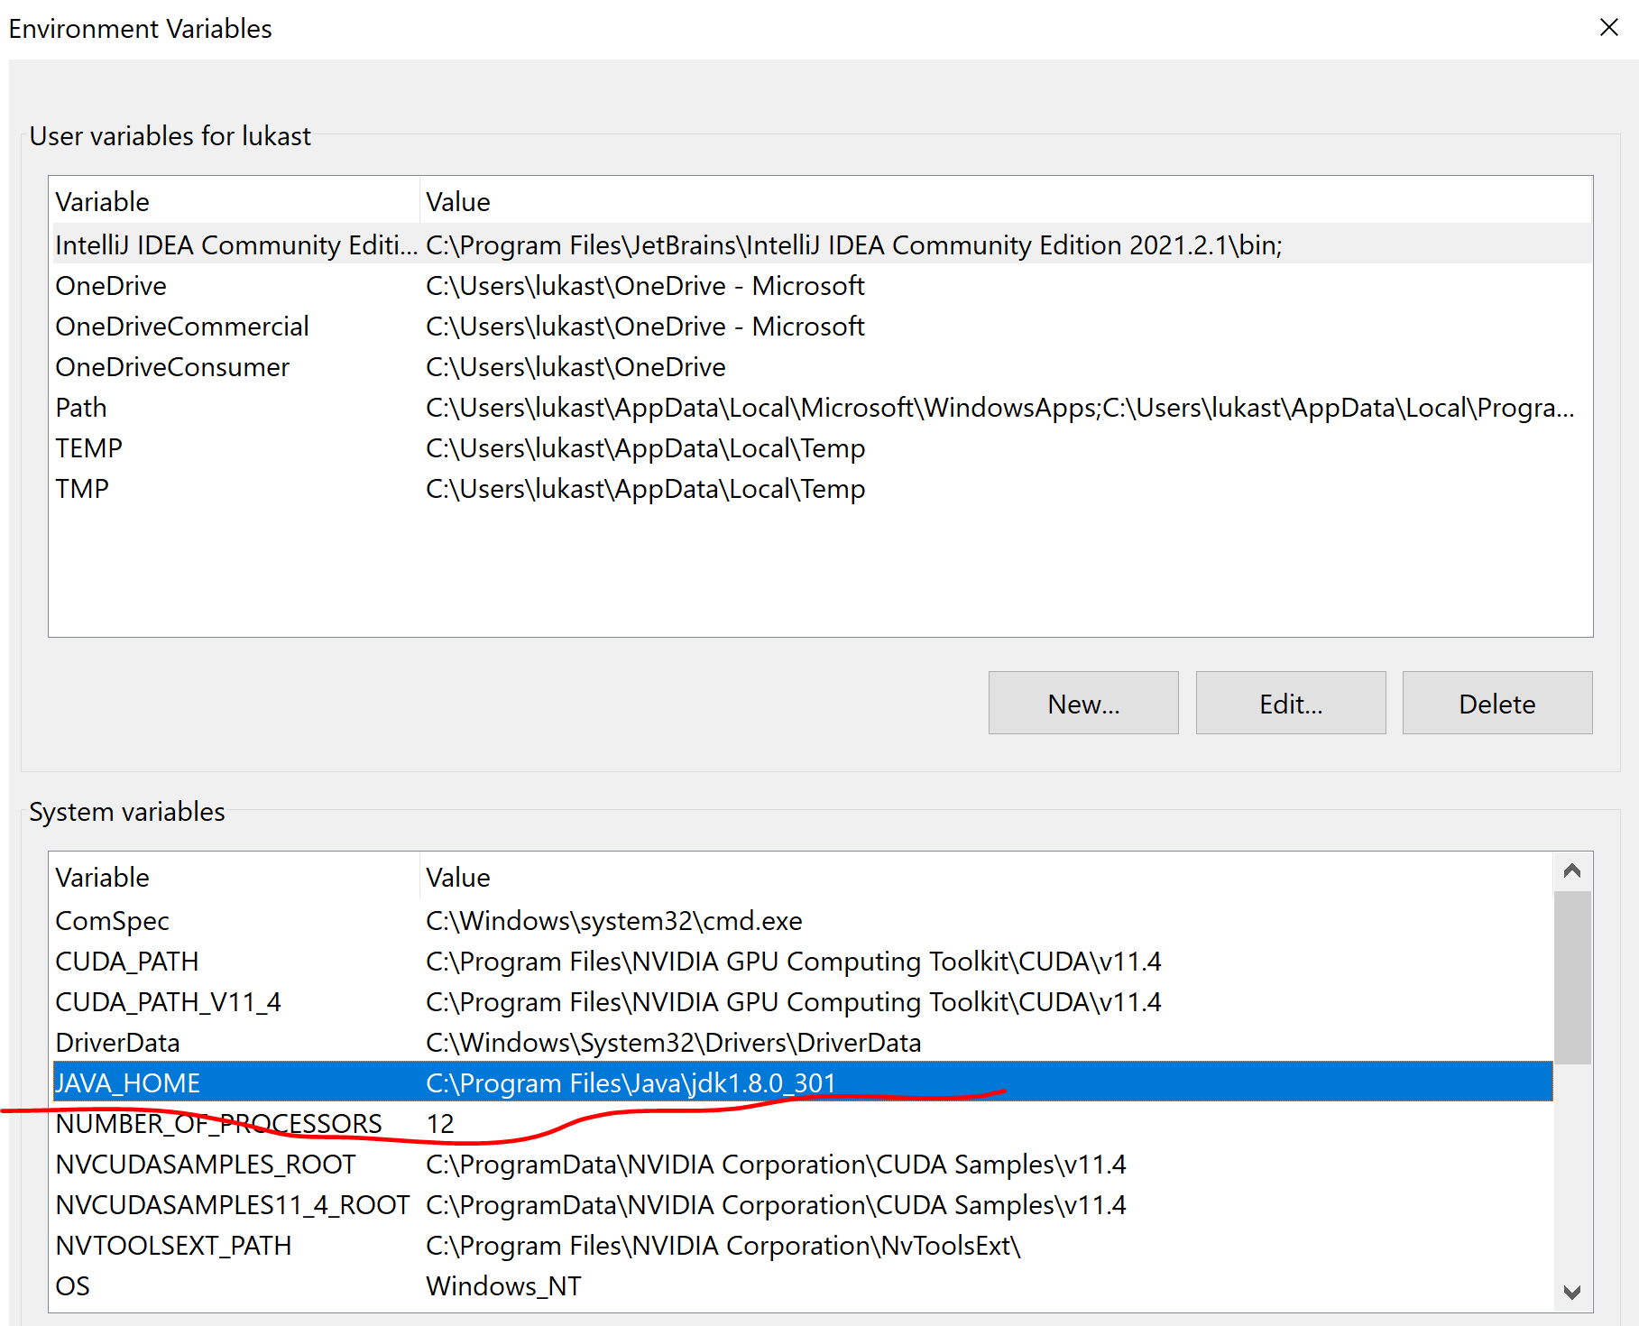
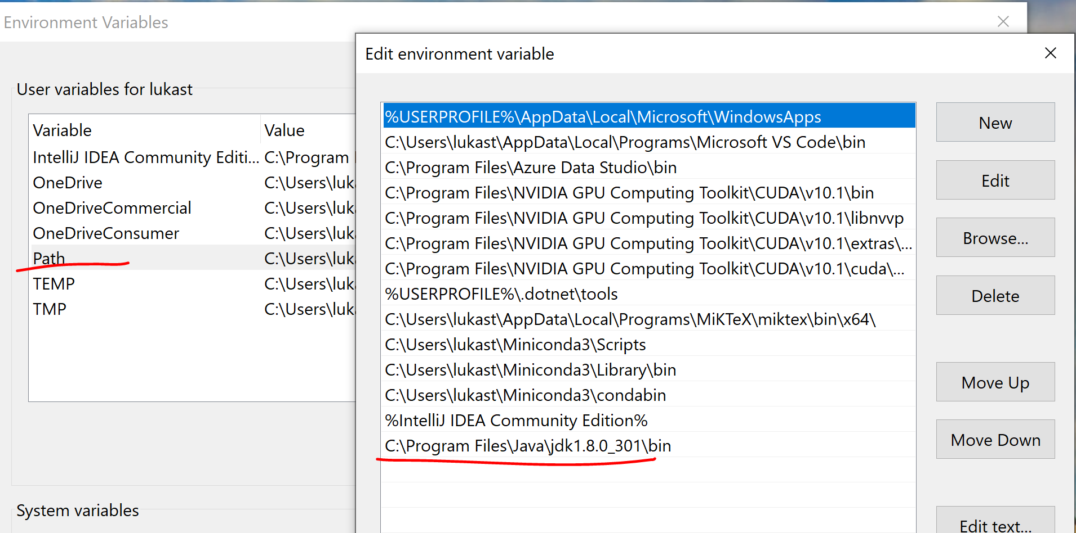
Environment Config

Slide 39
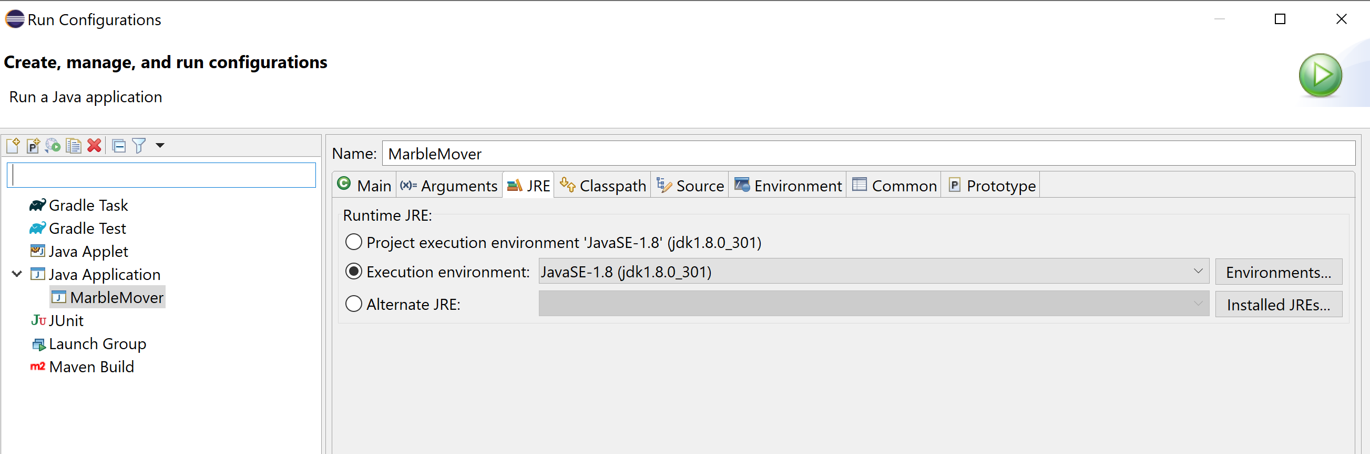
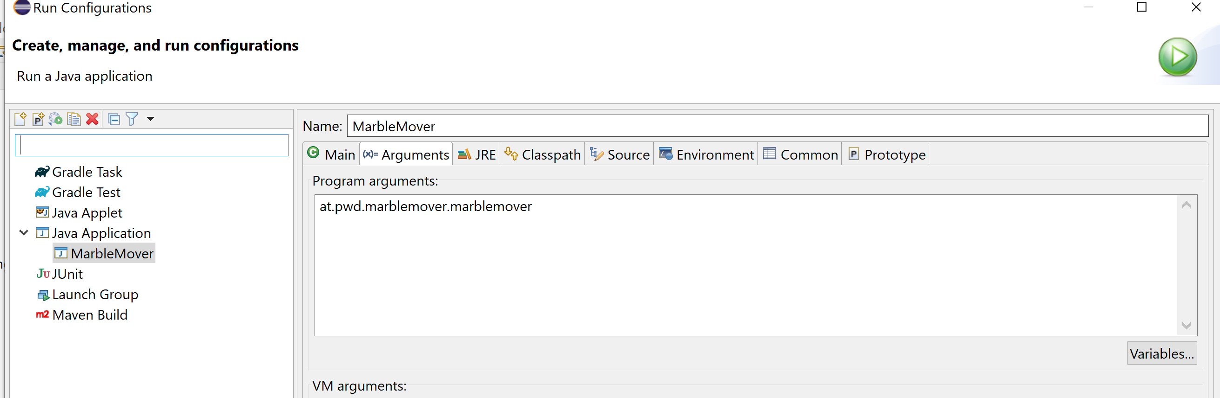
Eclipse Run Configuration

Slide 40
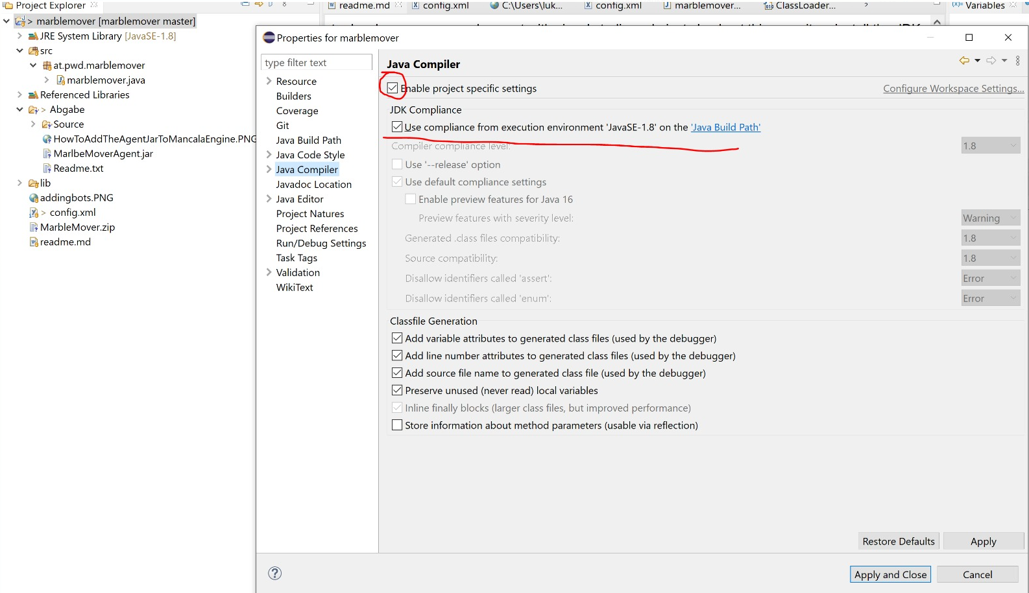
Change Compiler settings

Slide 41
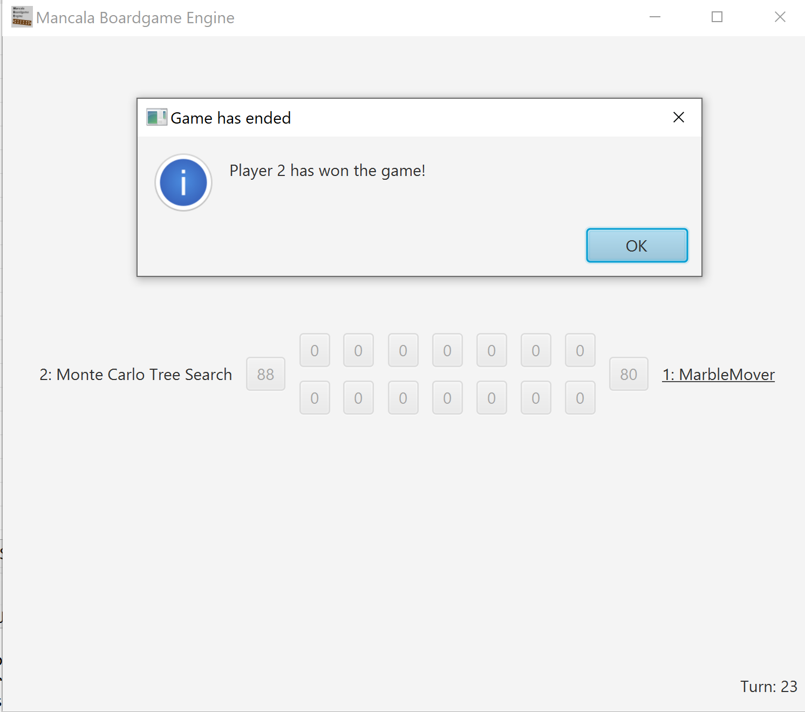
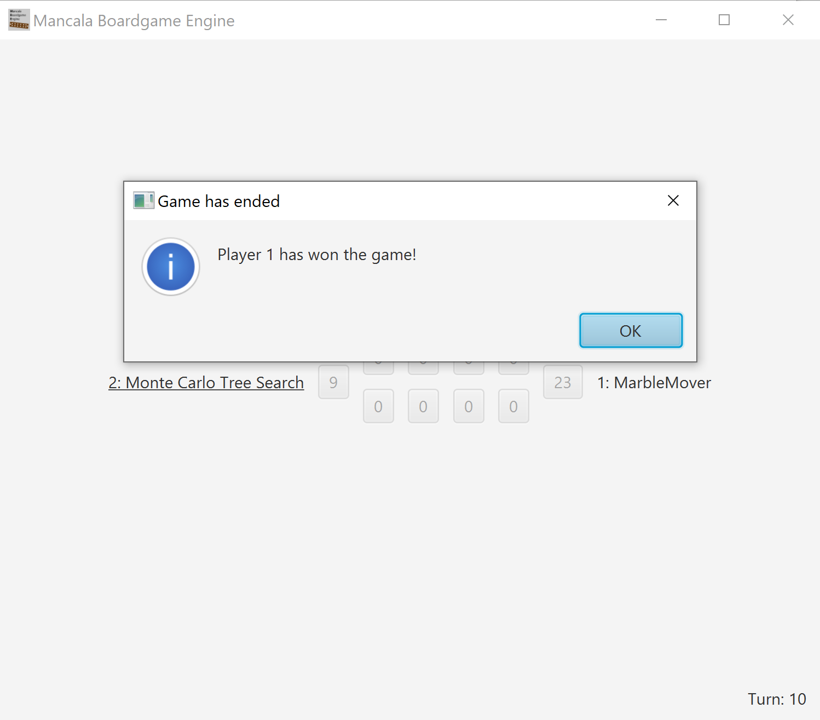
Example Play – MCTS outperforms Minimax on high branching factor

Slide 42
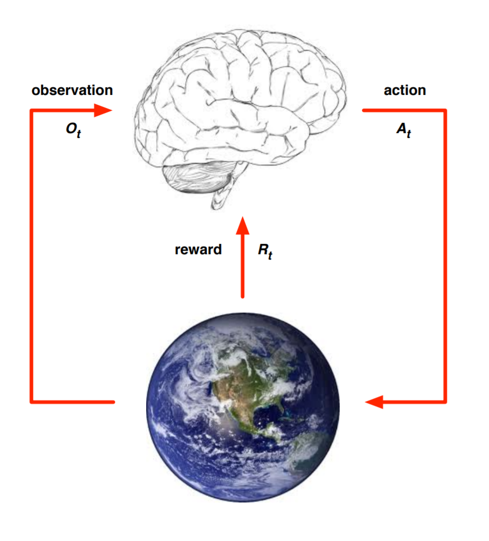
A brief introduction to Reinforcement Learning
Comparison to supervised learning:
No Ground Truth Labels to learn from
Instead you have an Environment as “Teacher”
Key idea, start by doing random actions.
At one point (early or late) you will receive a reward or penalty
Reinforce the actions that lead to higher reward.
https://www.davidsilver.uk/wp-content/uploads/2020/03/intro_RL.pdf
Notes:
https://www.davidsilver.uk/teaching/

Slide 43
Game Environments: Gym
Open AI Framework
Atari Games
Classic Control problems -> good for testing
Board Games
...
Issues: environments may work on windows or not.
Even Cause Bluescreens
Demo!
Notes:
https://gym.openai.com/
Install with
pip install gym
pip install keras

Slide 44
Example of a RL Algorithm Cross Entropy Method
Play N episodes using the current model and environment
Calculate reward for every episode
Keep only the top 70% of the episodes by reward
Train neural net on these “elite” episodes taking state as input and action as output.
Repeat till convergence

Slide 45
Model Based vs Model Free
Model Free
-> Directly Predicting the Action from the Observation
Used in complex (also stochastic environments)
Model Based
-> tries to predict the next observation and reward, (often multiple times) and then decides what action to take
Used in deterministic environments

Slide 46
On-Policy vs Off-Policy
On Policy – directly learning from the environment
Off Policy -> Learning from historical data e.g obtained by a previous version of the agent, or human recorded.)

Slide 47
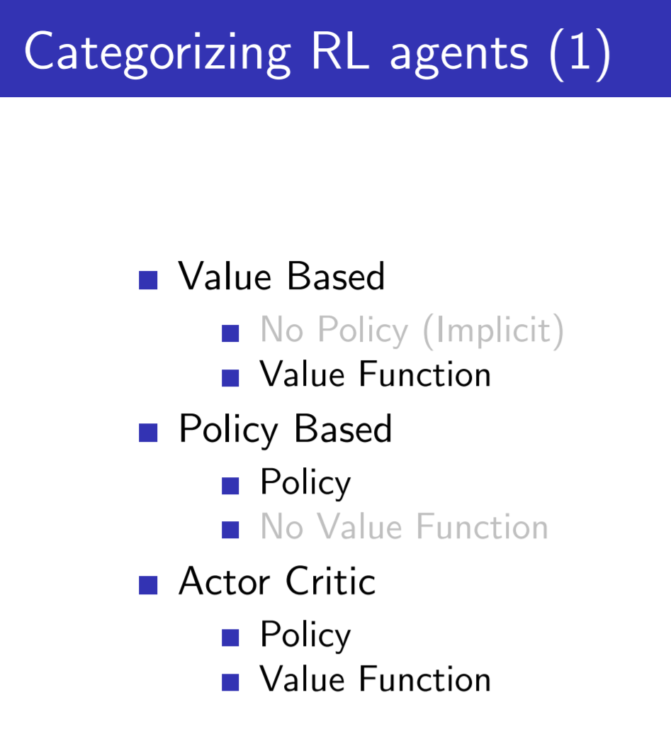
Policy Based -> Predicting a probability distribution over the next actions
Value Based -> Predicting the value of beeing in the next state

Slide 48
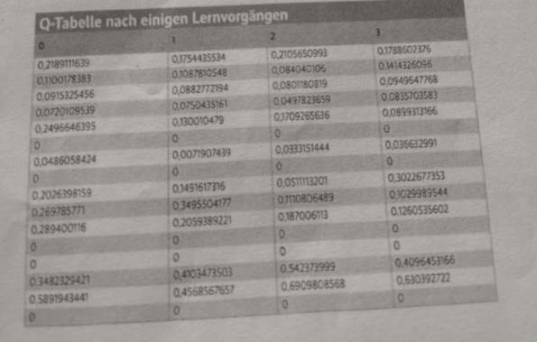
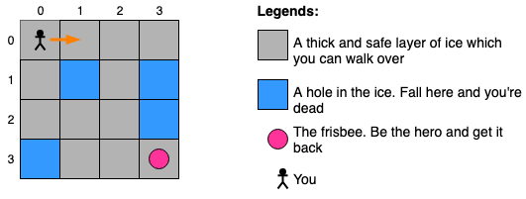
Value Based Method
For each next state estimate the discounted reward.
Easy when number of states is low and your world is deterministic.
Imagine you have all Q(s,a) -Values in a table
then you can take the action with highest Q-Value

Slide 49
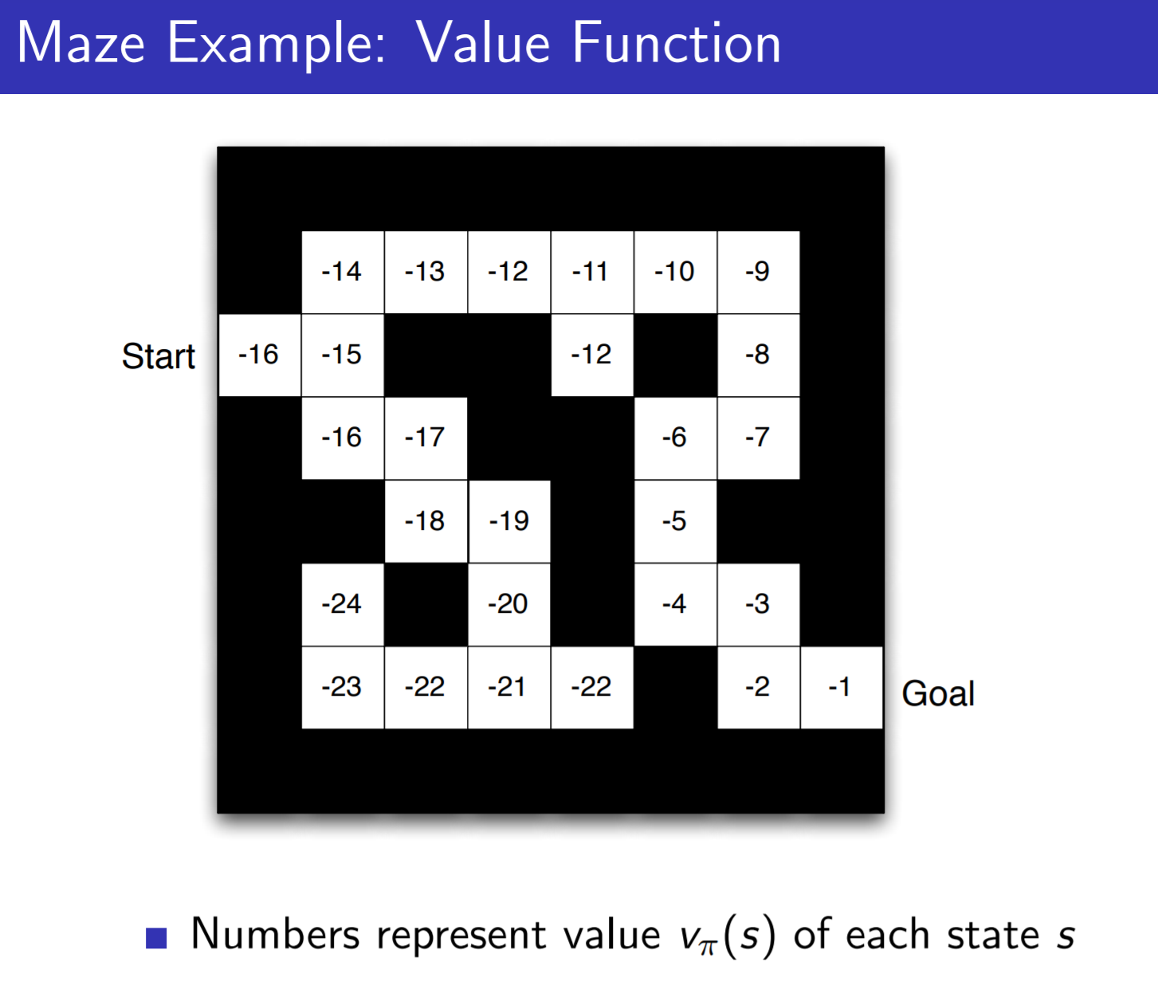
Example of a deterministic environment with a value for every
position:
Example of a stochastic environment:
https://reinforcement-learning4.fun/2019/06/09/introduction-reinforcement-learning-frozen-lake-example/

Slide 50
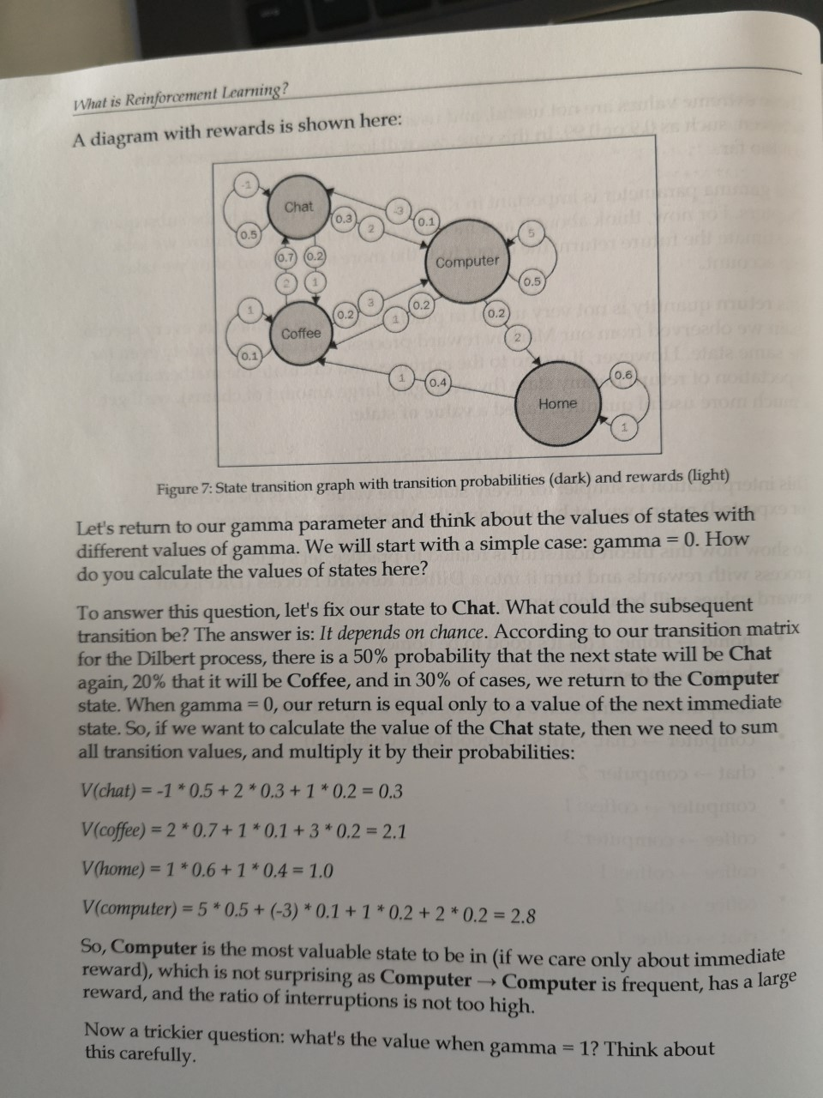
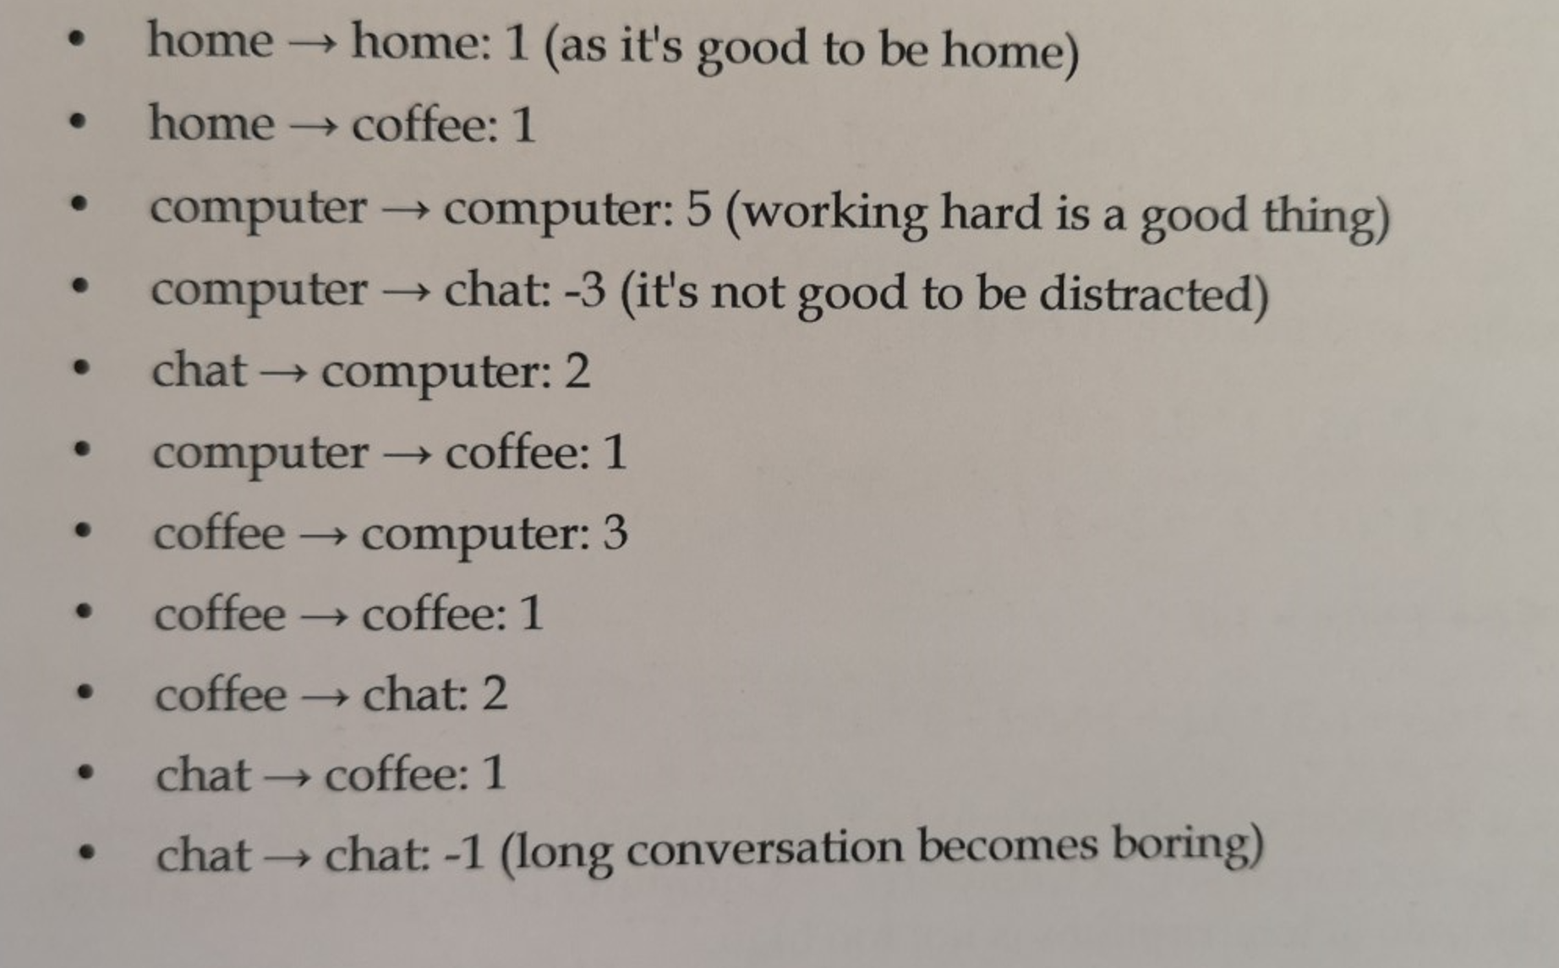
Markov Reward Process
How to obtain the Values of states in a stochastic environment?
Source: Maxim Lapan, Deep Reinforcement Learning Hands-On

Slide 51
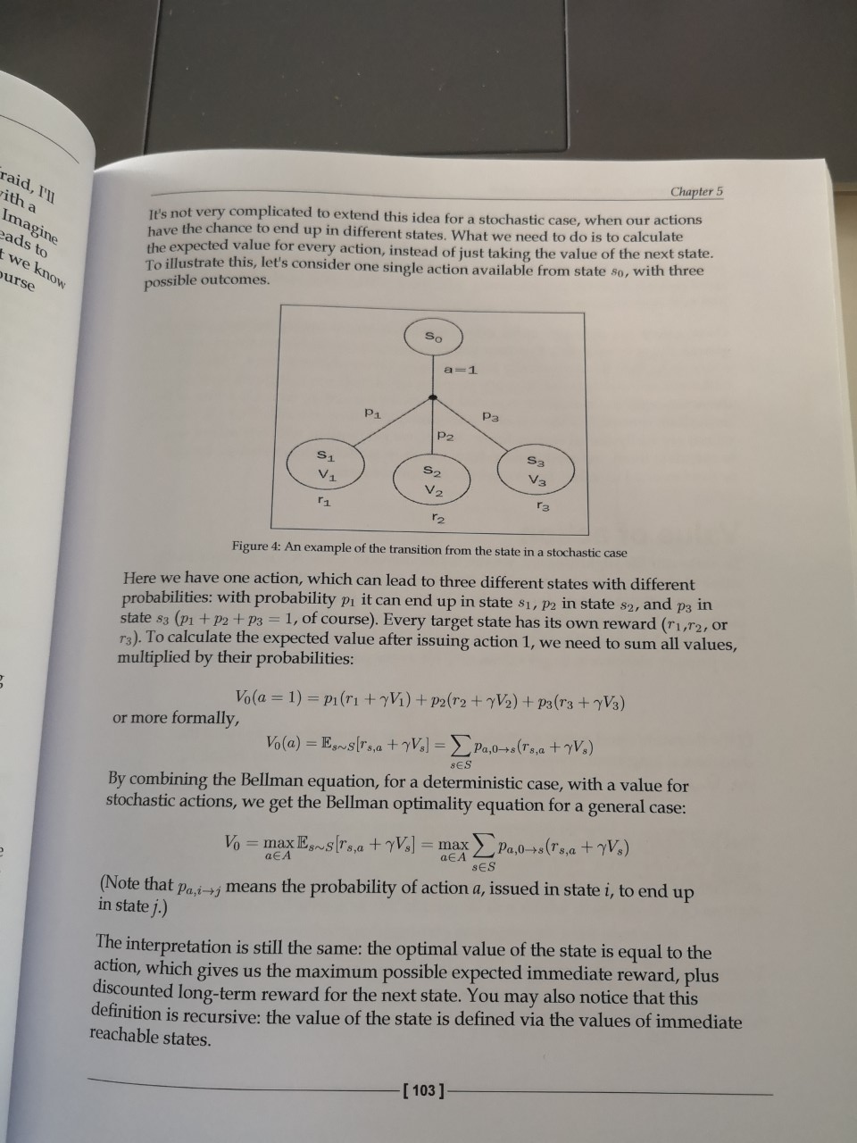
Bellman Equation
The Value of state x
is the maximum of the sum of
immediate reward and the discounted next states Value. Only the one action where the value is maximized is selected.
Recursive Definition!
Often you get the reward only at the end of
the game.
Source: Maxim Lapan, Deep Reinforcement Learning Hands-On

Slide 52
Example of a value based Method DQN
Simple Demo running in local rl Conda Environment
Bellman Equation visible in the code:
target = (reward + self.gamma * np.amax(self.model.predict(next_state)[0]))

Slide 53
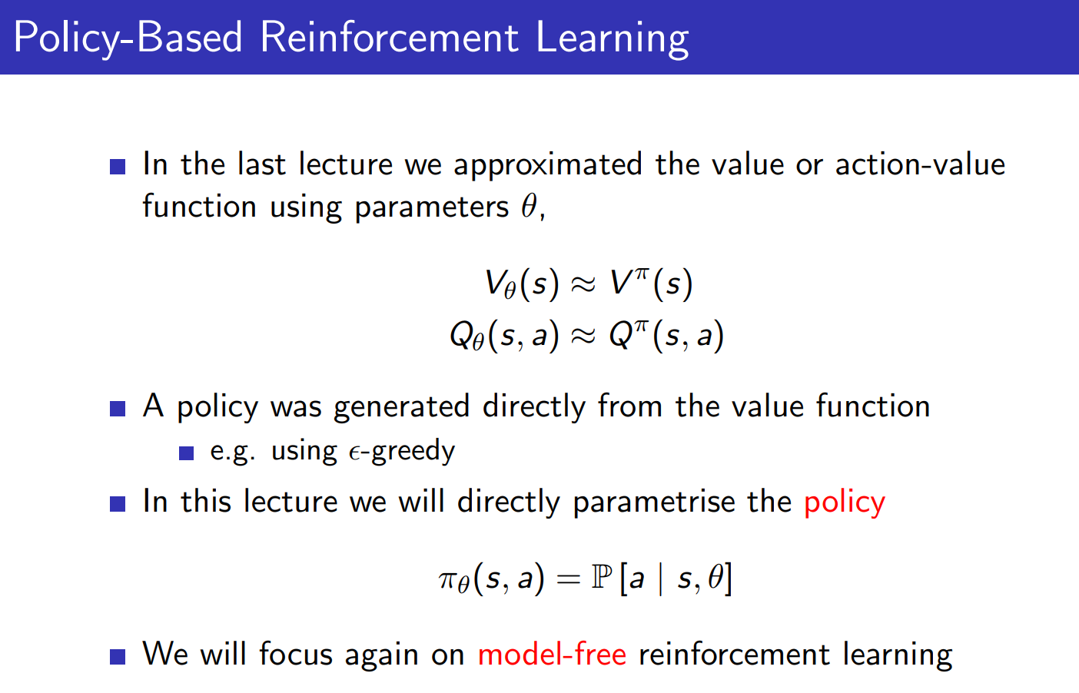

Slide 54
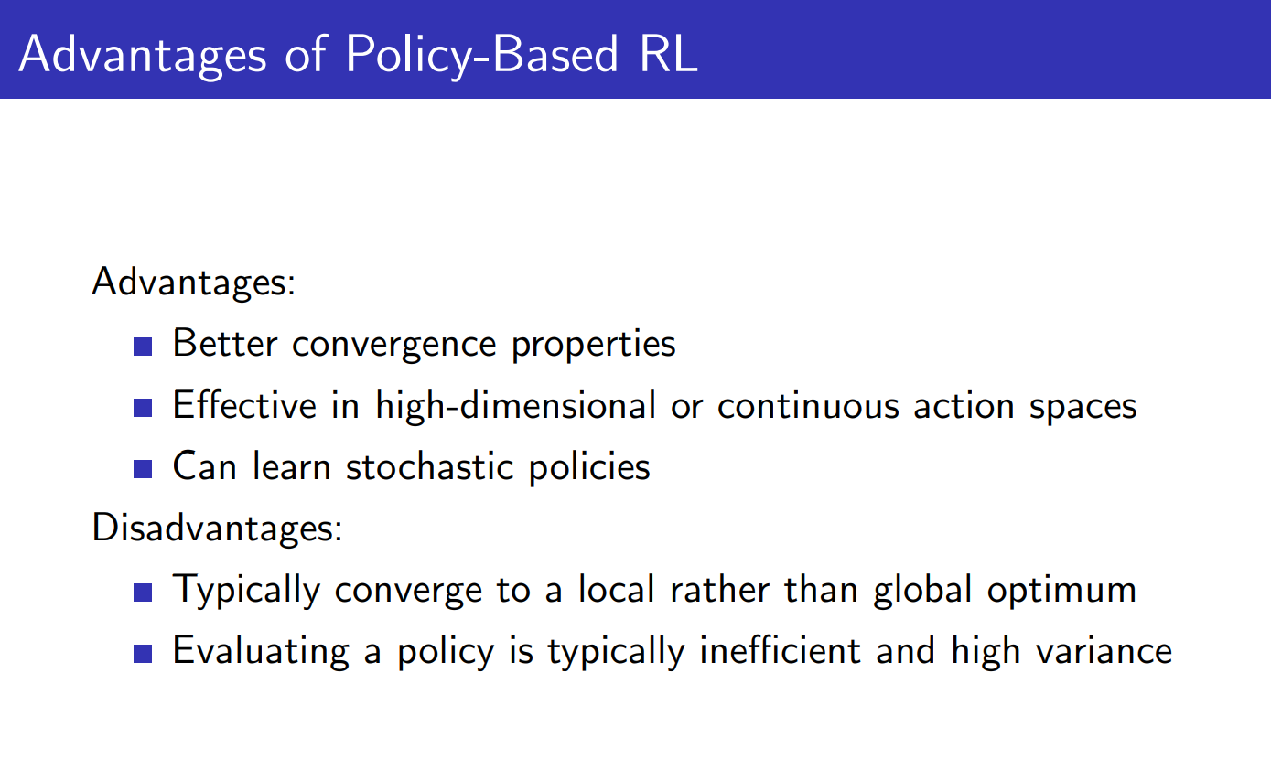

Slide 55
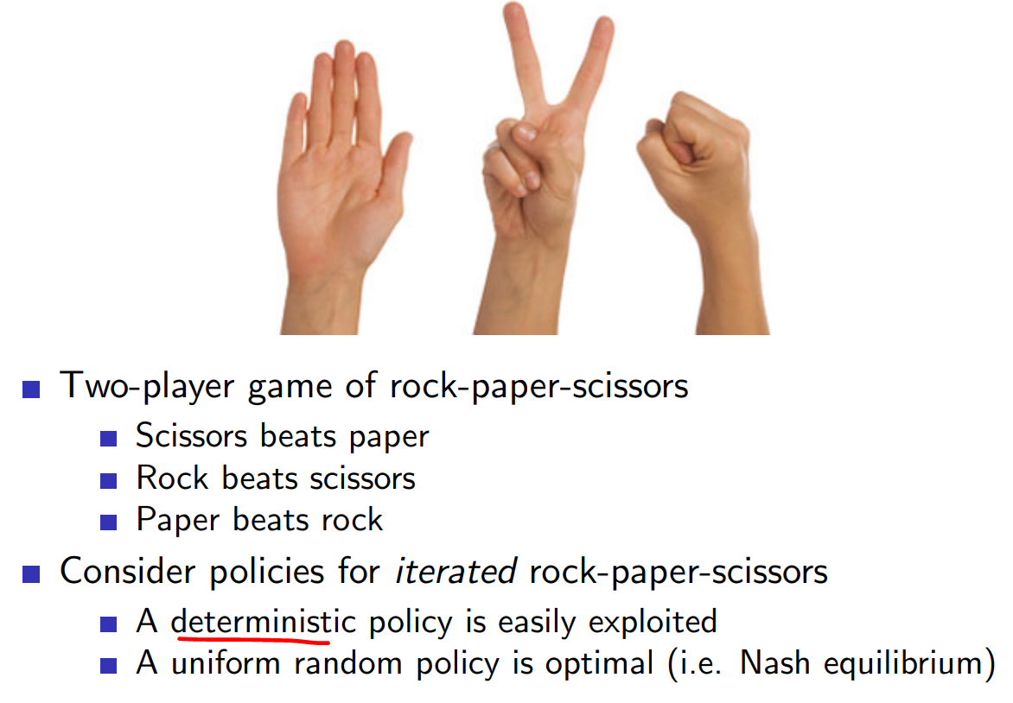
Notes:
This is an example where a stochastic policy is necessary. Because a deterministic one (where you play one action more often) can be exploited!

Slide 56
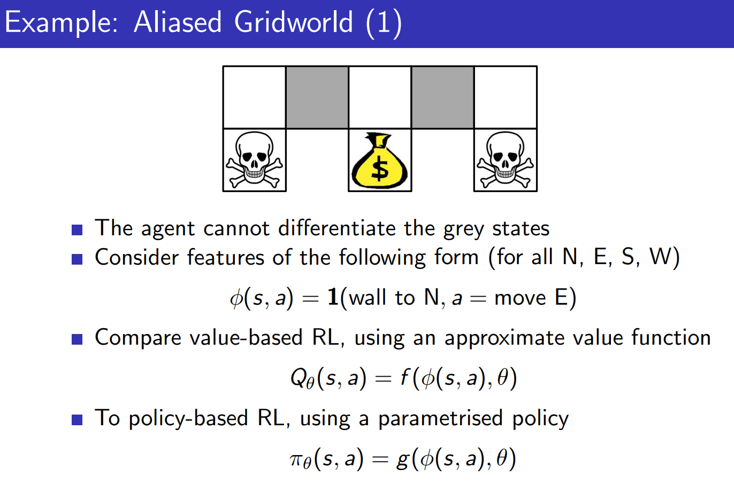
Notes:
Another problem when the Markov property does not hold.
You cannot distinguish the two gray fields based on the features that the agent gets (that describe the current state)

Slide 57
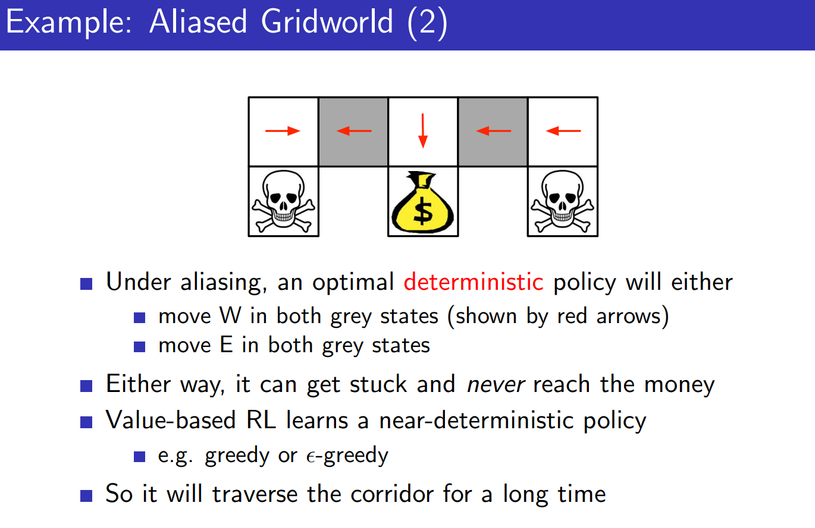
Notes:
So a deterministic policy would say you either go west all the time, or go east all the time.
Picking greedily the best value is a deterministic policy.

Slide 58
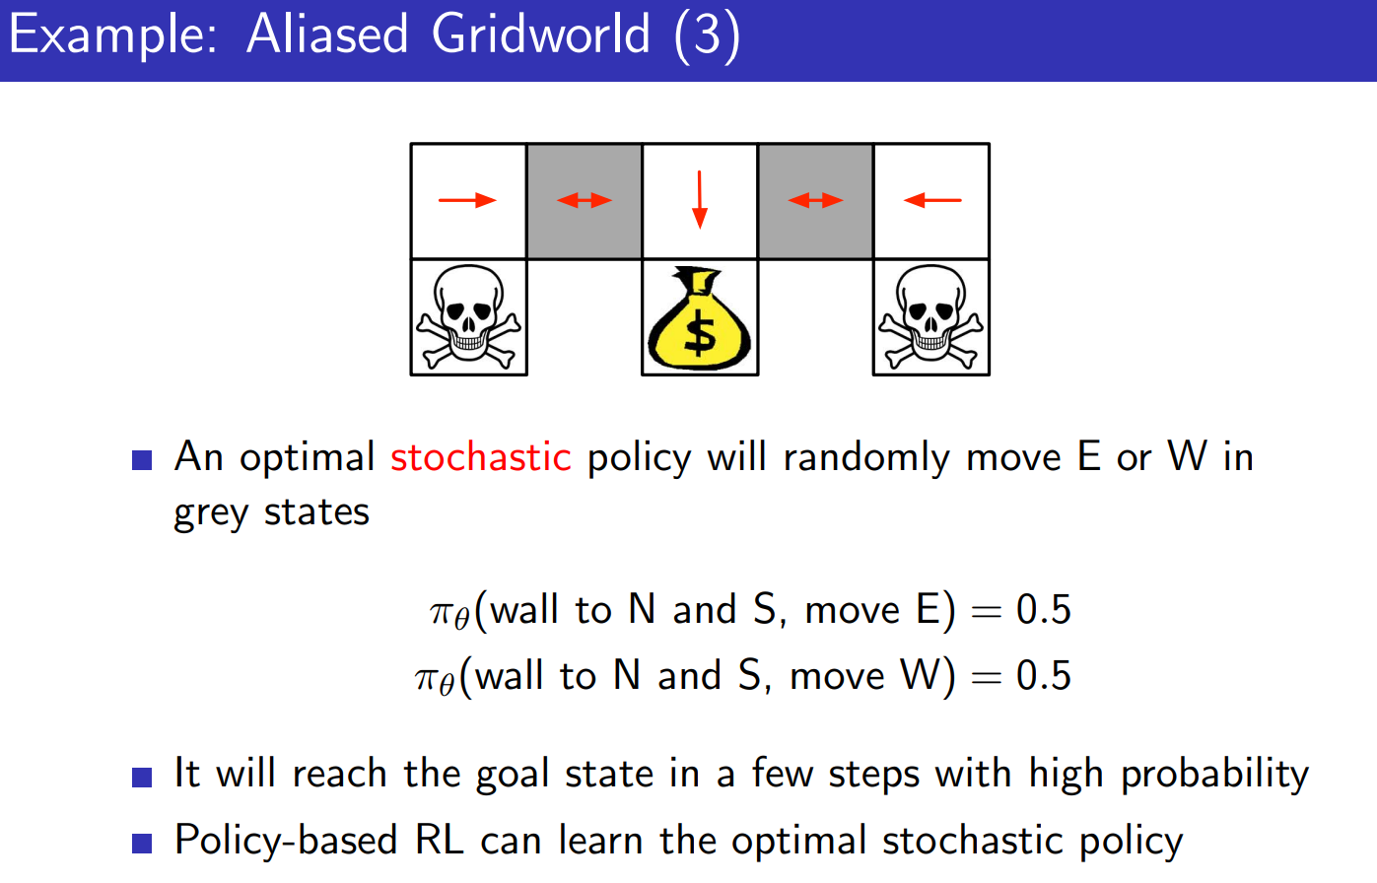
Notes:
So whenever state aliasing occurs a stochastic policy can do better than a deterministic policy.

Slide 59
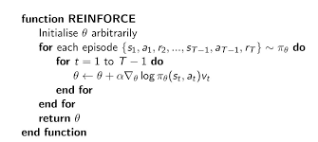
Example of a Policy Based Method REINFORCE
https://medium.com/@thechrisyoon/deriving-policy-gradients-and-implementing-reinforce-f887949bd63
Demo:
https://cs.stanford.edu/people/karpathy/reinforcejs/gridworld_dp.html

Slide 60
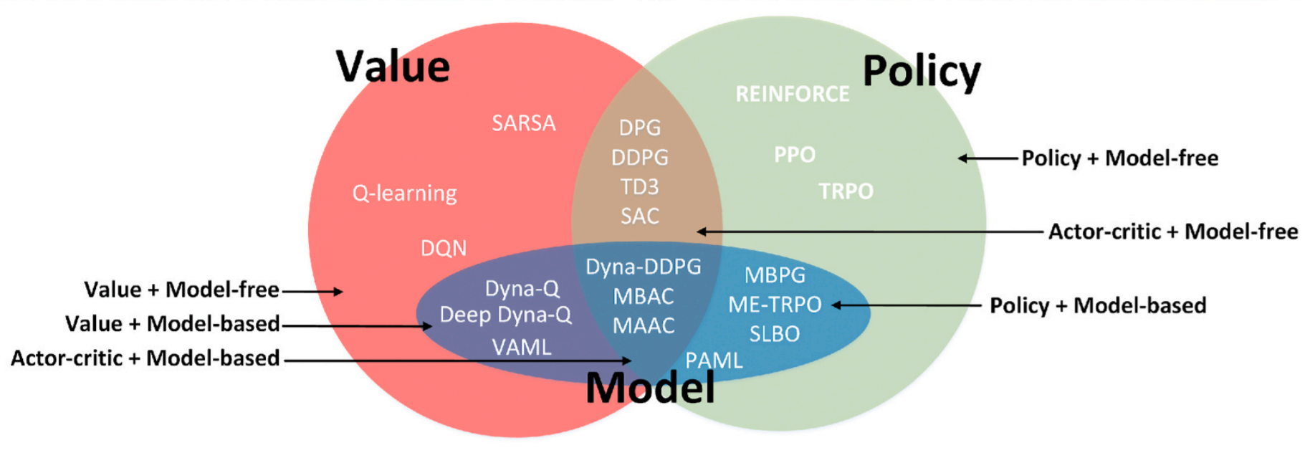
Reinforcement Learning
Policy based is better in case of broken Markov property.
Value based is often more sample efficient (not necessarily more computationally efficient)
https://www.davidsilver.uk/wp-content/uploads/2020/03/pg.pdf
https://www.youtube.com/watch?v=KHZVXao4qXs&ab_channel=DeepMind

Slide 61
Development Environment Options
Directly on your Windows Desktop Client
Windows /Linux Dual Boot
Linux Subsystem -> just no
Docker
Azure Data Science VM
Azure ML + Ray RLLib
Notes:
Docker -> Resource Intensive & Slow -> GPU Configuration may take ages!
Directly on Windows Desktop Client -> big issues with Gym Framework
Azure ML -> Black Box (uses Docker in the background) 3 Month tutorial fails without error message -> some trial & error to identify again that the docker environment causes problems.
Azure Datascience VM -> simples Option for Learning Purpose (Downside -> fast aging image (many libraries update frequently) – often easier to create a new vm after a while than patching the existing one.

Slide 62
Reinforcement Learning with Azure Machine Learning
Mario O. Bourgoin, PhD
12/5/2019
Acknowledgements: Keiji Kanazawa

Slide 63
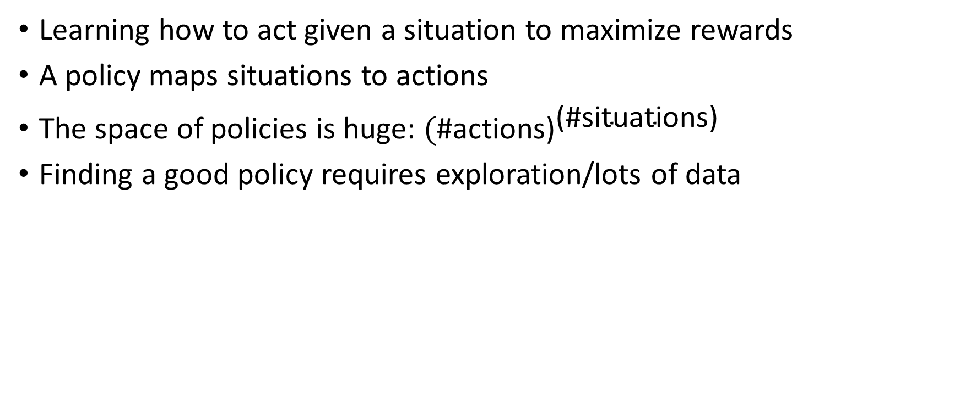
Reinforcement Learning
Learning how to act given a situation to maximize rewards
A policy maps situations to actions
The space of policies is huge: ${\text{(}\text{\#}\text{actions}\text{)}}^{\text{(\#}\text{situations}\text{)}}$
Finding a good policy requires exploration/lots of data

Slide 64
Azure ML Reinforcement Learning
Managed RL service for large scale distributed simulation and training, using Ray/RLlib framework
Customers create compute clusters and submit simulation/training jobs using standard Azure ML pattern with SDK & CLI
RL algorithms are in RLlib – Deep training is Tensorflow by default, Pytorch possible
Available in azureml-sdk 1.0.76

Slide 65
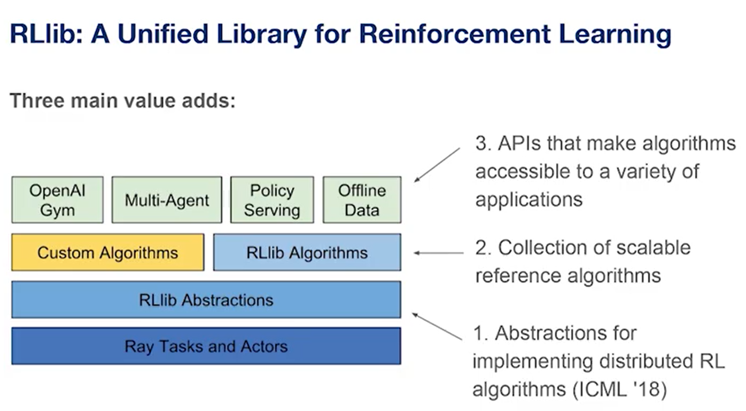
RAY
Custom Environments RLlib Environments — Ray v2.0.0.dev0 , Example with external Game Engine:
ray/unity3d_server.py at master · ray-project/ray (github.com)
Available Algorithms: RLlib Algorithms — Ray v1.6.0
https://www.youtube.com/watch?v=8tG8PJC6oaU&ab_channel=AICamp

Slide 66

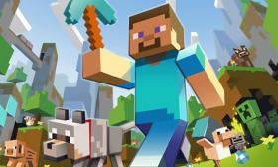
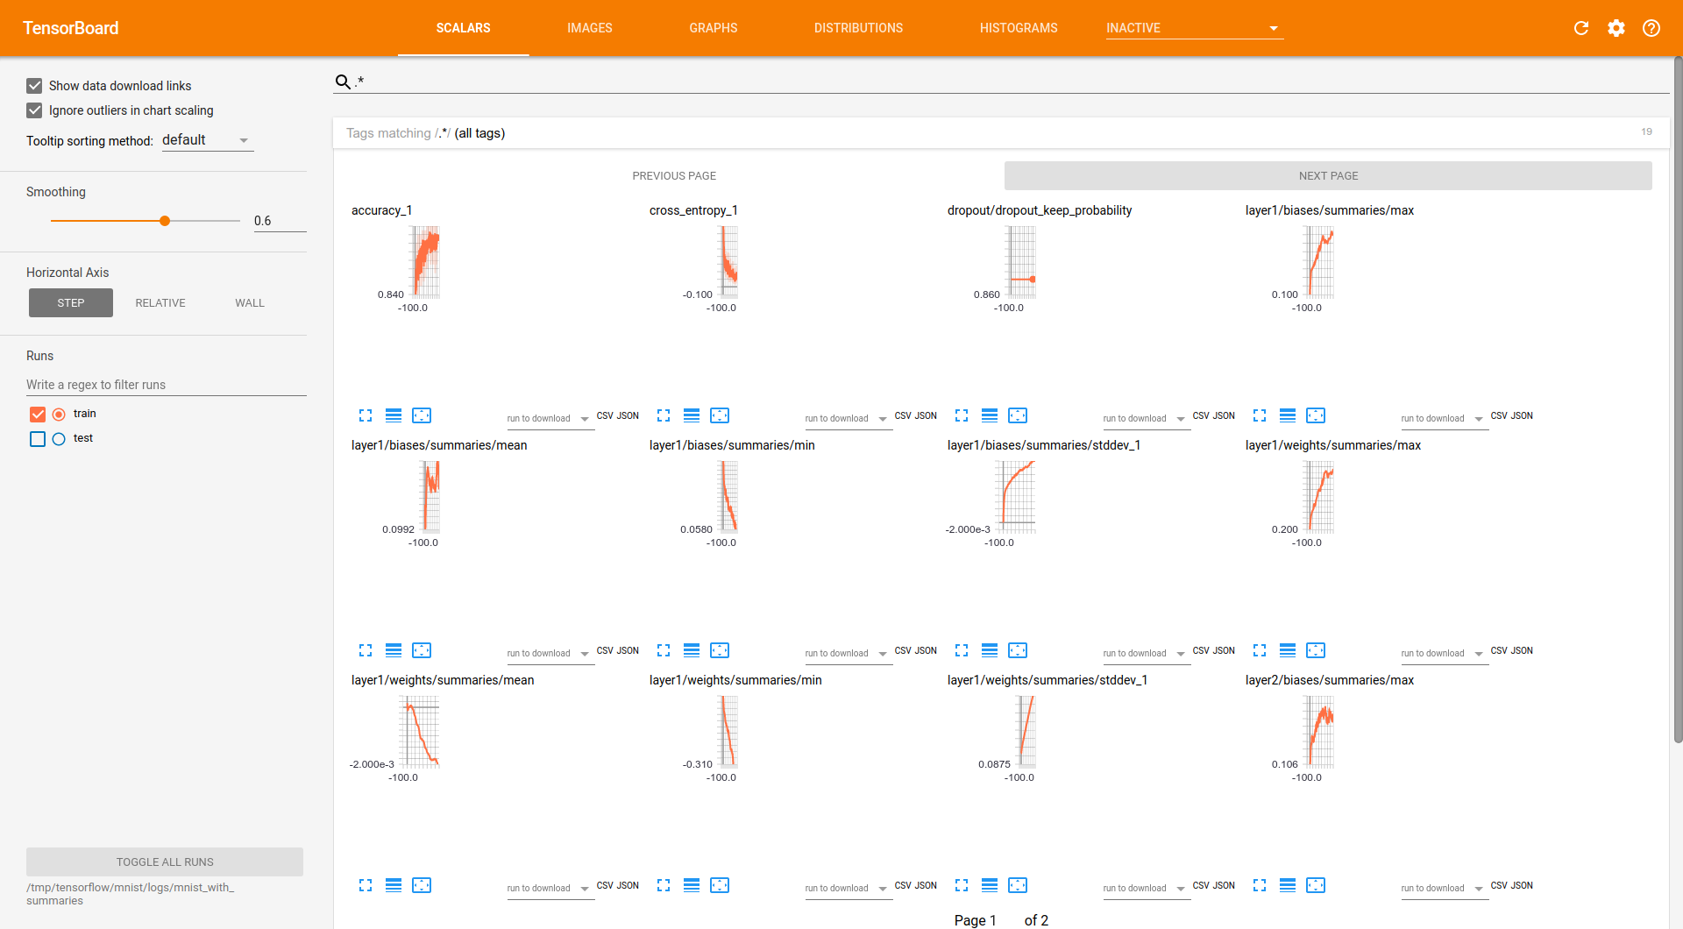
How It Works
Azure Machine Learning
Ray Cluster
Simulator Cluster
Head Node (Training)
Data Scientist Submits Experiment
Worker Node
Simulator Node
Worker
Worker
Sim
Sim
Worker Node
Simulator Node
Worker
Worker
Sim
Sim
Training Results

Slide 67
Requirements
100’s of parallel simulations
Training: multiple days
Multiple Ray jobs
Resilient to simulator / worker failures
ML Ops pipeline integration

Slide 68
Simulators
Open AI Gym
Custom simulators with Open AI Gym Environment interface – worker local or remote in simulator
Windows support
Investigating additional simulator support

Slide 69
Simple Demo
Shows the simple cartpole_sc.ipynb
Shows compute cluster and how to look at the logs & output
Notes:
C:\Users\lukast\Documents\mln
Show the simple cartpole_sc.ipynb
Show compute cluster and how to look at the logs & output

Slide 70
Advanced Demo
Shows the atari-on-distributed compute.ipynb
Shows compute cluster and how to look at the logs & output
Notes:
C:\Users\lukast\Documents\mln
Show the simple cartpole_sc.ipynb
Show compute cluster and how to look at the logs & output

Slide 71
Next Steps
Learn about Ray/Rllib
O’Reilly AI tutorial: Scalable AI and reinforcement learning with Ray
http://aka.ms/mslibrary
Create examples using Ray/Rllib
Start by running tutorial examples on AMLS?

Slide 72
Issues with Cartpole
For the cartpole rl on sc demo I had some missing python packages in the docker image (resulting in an error when trying to capture the video) -> fixed this in a fork of the repo and created pull request
Missing Azure CLI for the Atari Distributed pong Demo
Install the Azure CLI for Windows | Microsoft Docs

Slide 73

Issues with Pong
File "/opt/miniconda/lib/python3.7/site-packages/tensorflow/python/client/session.py", line 1149, in _run
str(subfeed_t.get_shape())))
ValueError: Cannot feed value of shape (4, 4, 4, 16) for Tensor 'default_policy/Placeholder_default_policy/conv1/kernel:0', which has shape '(8, 8, 4, 16)'
2021-08-25 15:51:15.470861: CPU Usage: 24.1%, Memory Usage: 6.0%, Memory Total/Available: 59074052096/55516184576
[2m[36m(pid=147)[0m /opt/miniconda/lib/python3.7/site-packages/tensorboard/compat/tensorflow_stub/dtypes.py:541: FutureWar

Slide 74
If time permits
Alpha Go
Alpha Go Zero
Alpha Star
Mü Zero

Slide 75
AlphaGo
Policy Network to predict potential moves (Reducing the breadth of the search tree)
Value Network to predict the outcome of the game (reducing the depth of the search tree)
Deepmind AlphaZero - Mastering Games Without Human Knowledge - YouTube

Slide 76
AlphaGo Zero
Essentialy Montecarlo Tree search with selfplay.
Only One Network trained using self play
No Random MCTS Rollouts (Problems occur if random rollouts often lead to wins by accident you start to believe certain positions are very effective)
Single Network guides the MCTS Algorithm, suggesting moves -> then play that move run another search(using the model and so on... Till game is completed.
Then they trained a policy network P‘ to predict what the MCTS would have produced.
Also trained a new value network V‘ that predicts the winner based on the board
Search based policy iteration (policy improvement , policy valuation) Alternate between the stages gives you stronger and stronger policies.
Critical Success Factor: Search based policy evaluation! (testing a new policy by seeing what the value is when playing it to the end)
Deepmind AlphaZero - Mastering Games Without Human Knowledge - YouTube

Slide 77
Alpha Zero
Works similar to the human way of playing … looking at promising moves (simulating the next steps) ignoring obviously bad moves.
Value Network -> Takes Game State as Input -> outputs value of that state. Very simple function approximation from sequences.
Policy Network -> trained such that the output is the same as MCTS
MCTS uses Policy Network to determine which positions are promissing
Notes:
https://www.youtube.com/watch?v=MPXGiowUr0o&ab_channel=SkowstertheGeek
https://www.youtube.com/watch?v=62nq4Zsn8vc&ab_channel=JoshVarty

Slide 78

Notes:
Mue Zero Trained 2 weeks, -> requires just a normal desktop machine for inference.

Slide 79
Alpha Star
https://www.youtube.com/watch?v=DMXvkbAtHNY&ab_channel=TwoMinutePapers

Slide 80
MuZero
Translates the pixel space into an abstract space used for planning,
Dynamics model to predict next state
https://www.youtube.com/watch?v=L0A86LmH7Yw&ab_channel=JulianSchrittwieser

Slide 81
Appendix
https://techcommunity.microsoft.com/t5/azure-ai/introducing-reinforcement-learning-on-azure-machine-learning/ba-p/1403028
https://github.com/Azure/MachineLearningNotebooks/tree/master/how-to-use-azureml/reinforcement-learning
https://github.com/ray-project/ray
http://karpathy.github.io/2016/05/31/rl/
https://cs.stanford.edu/people/karpathy/reinforcejs/gridworld_dp.html

Slide 82



Literature
The standard textbook for AI
Easy, with code examples to reproduce
http://incompleteideas.net/book/RLbook2018.pdf
Math heavy but well explained here:
https://www.youtube.com/watch?v=4SLGEq_HZxk&t=0s&ab_channel=HenryAILabs

